Slide 1

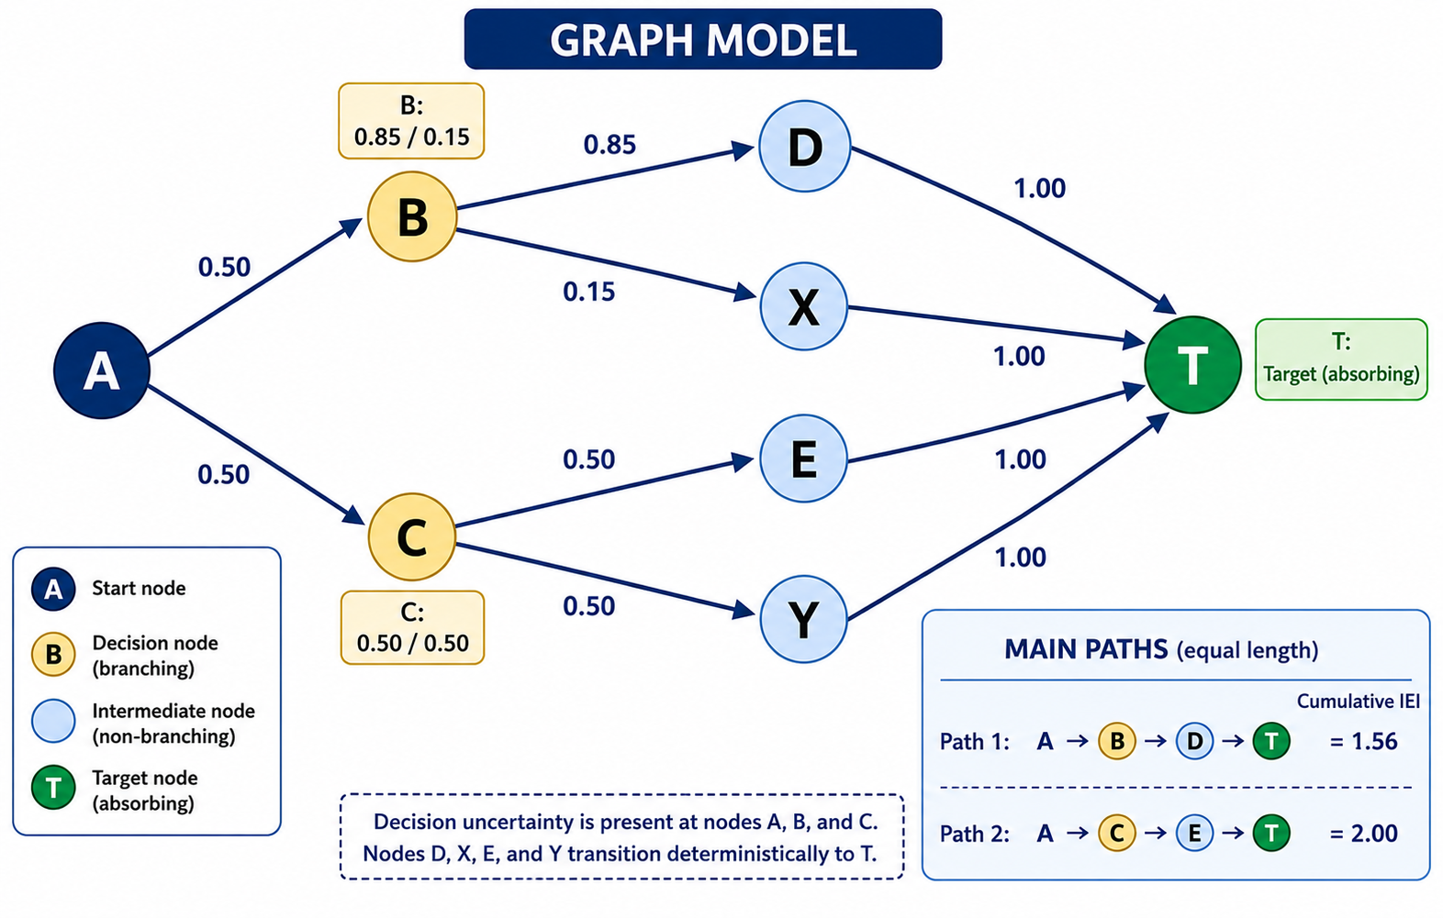
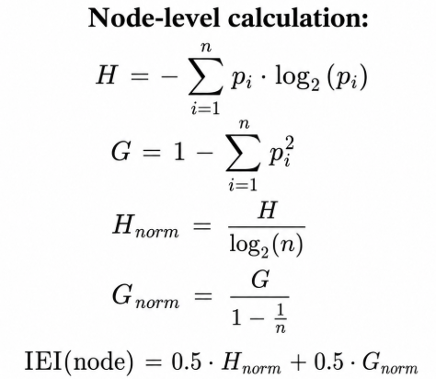

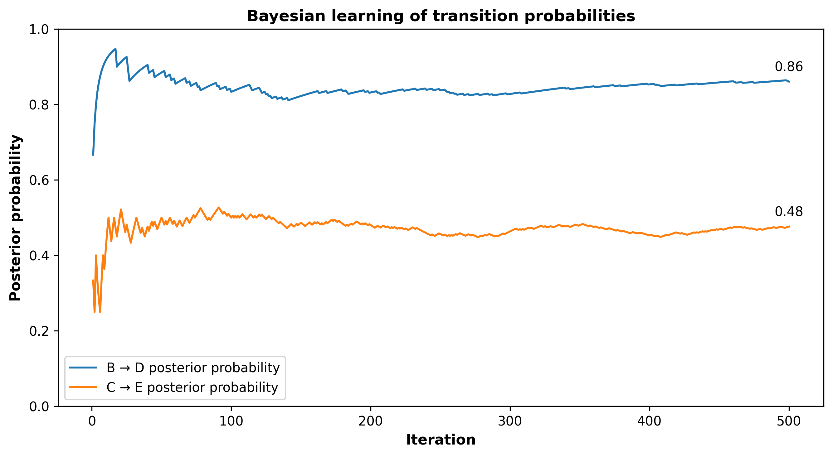
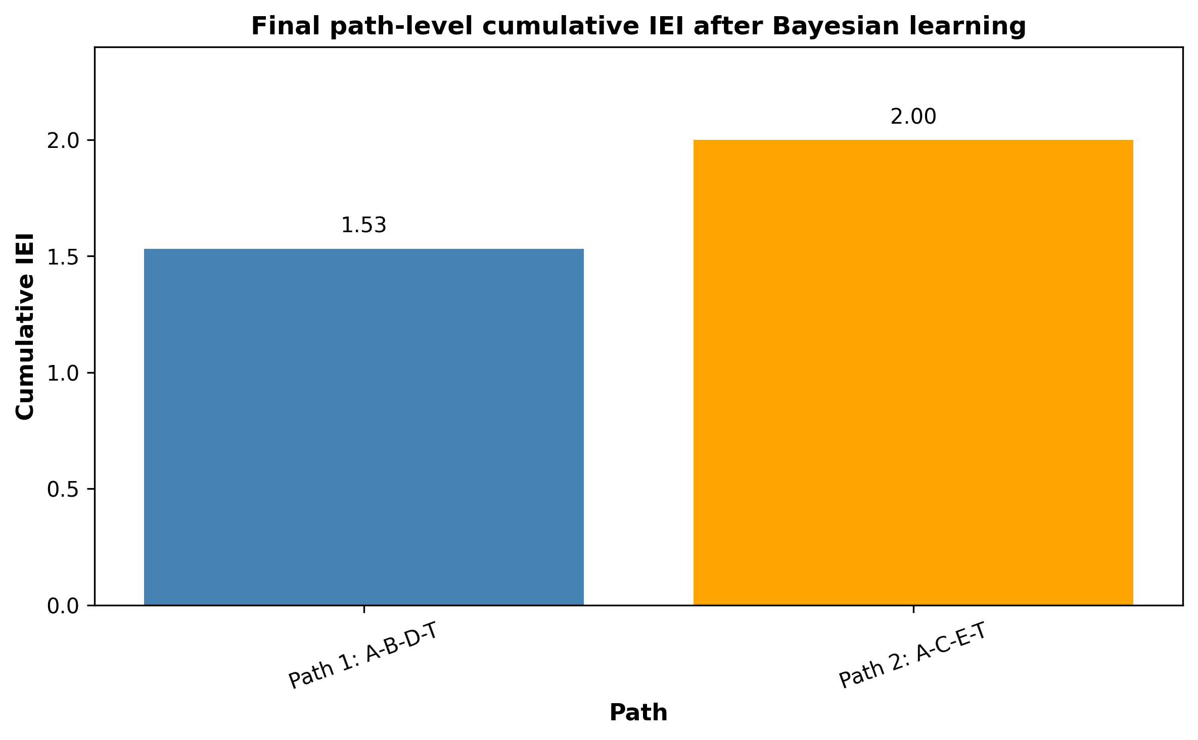
Uncertainty-Aware Path Selection in Graphs Using an Adapted Imprecision Entropy Indicator
Peter Domjan¹, Viola Angyal², Dr. Adam Bertalan³, Dr. Istvan Vingender⁴
Prof. Dr. Elek Dinya⁵
¹ ² ³ Doctoral College, Health Sciences Division
⁴ Faculty of Health Sciences, Department of Social Sciences
⁵ Faculty of Public Services, Institute of Digital Health Sciences
INTRODUCTION
SCENARIO TABLE
GRAPH MODEL
Traditional graph-based path evaluation usually focuses on distance or cost. However, equal-length paths may differ in their decision uncertainty. This proof-of-concept study introduces a graph-adapted Imprecision Entropy Indicator (IEI) to quantify uncertainty at node and path levels, extending the conceptual logic of a previously developed IEI framework to directed graph structures.
Scenario | Setting | Outcome
1. Symmetric | A, B, C: 0.50 / 0.50 | Similar path-level IEI
2. Stable vs Uncertain | B: 0.85/0.15; C: 0.50/0.50 | Lower IEI for the stable path
3. Bayesian Learning | 500 updates; simulated transitions generated from fixed probabilities: B = 0.85 / 0.15, C = 0.50 / 0.50 | Posterior transition probabilities and path-level IEI
OBJECTIVE
This proof-of-concept study aims to evaluate whether a graph-adapted Imprecision Entropy Indicator (IEI) can quantify uncertainty at decision nodes and identify lower-uncertainty paths among equal-length alternatives. The proposed IEI combines entropy-based uncertainty, graph topology, and Bayesian updating to assess uncertainty at the path level rather than at individual nodes alone.
The graph contained four A-to-T paths grouped into two equal-length families: A–B–{D/X}–T and A–C–{E/Y}–T. Branching uncertainty occurred at A, B, and C, while D, E, X, and Y transitioned deterministically to T.
Figure 1. Directed graph model (Scenario 2)
IEI CALCULATION
pᵢ probability of outgoing edge i
H Shannon entropy
G Gini impurity,
n the number of outgoing edges.
RESULTS
Figure 2. Bayesian learning of transition probabilities (Scenario 3)
Figure 3. Stable vs Uncertain branching (Scenario 3)
RESULTS
Equal-length paths can differ in uncertainty.
CONCLUSION
LIMITATIONS
Equal-length graph paths may differ substantially in cumulative decision uncertainty. The graph-adapted IEI identified lower-uncertainty routes by combining entropy-based uncertainty measures with Bayesian learning.
• Simplified proof-of-concept graph model
• Predefined transition probabilities
• Simulated Bayesian learning only
• Real-world validation is still required
BIOMED-DATA 2026 Peter Domjan
BUDAPEST, JULY 15-17, 2026 domjan.peter@phd.semmelweis.hu

