Slide 1
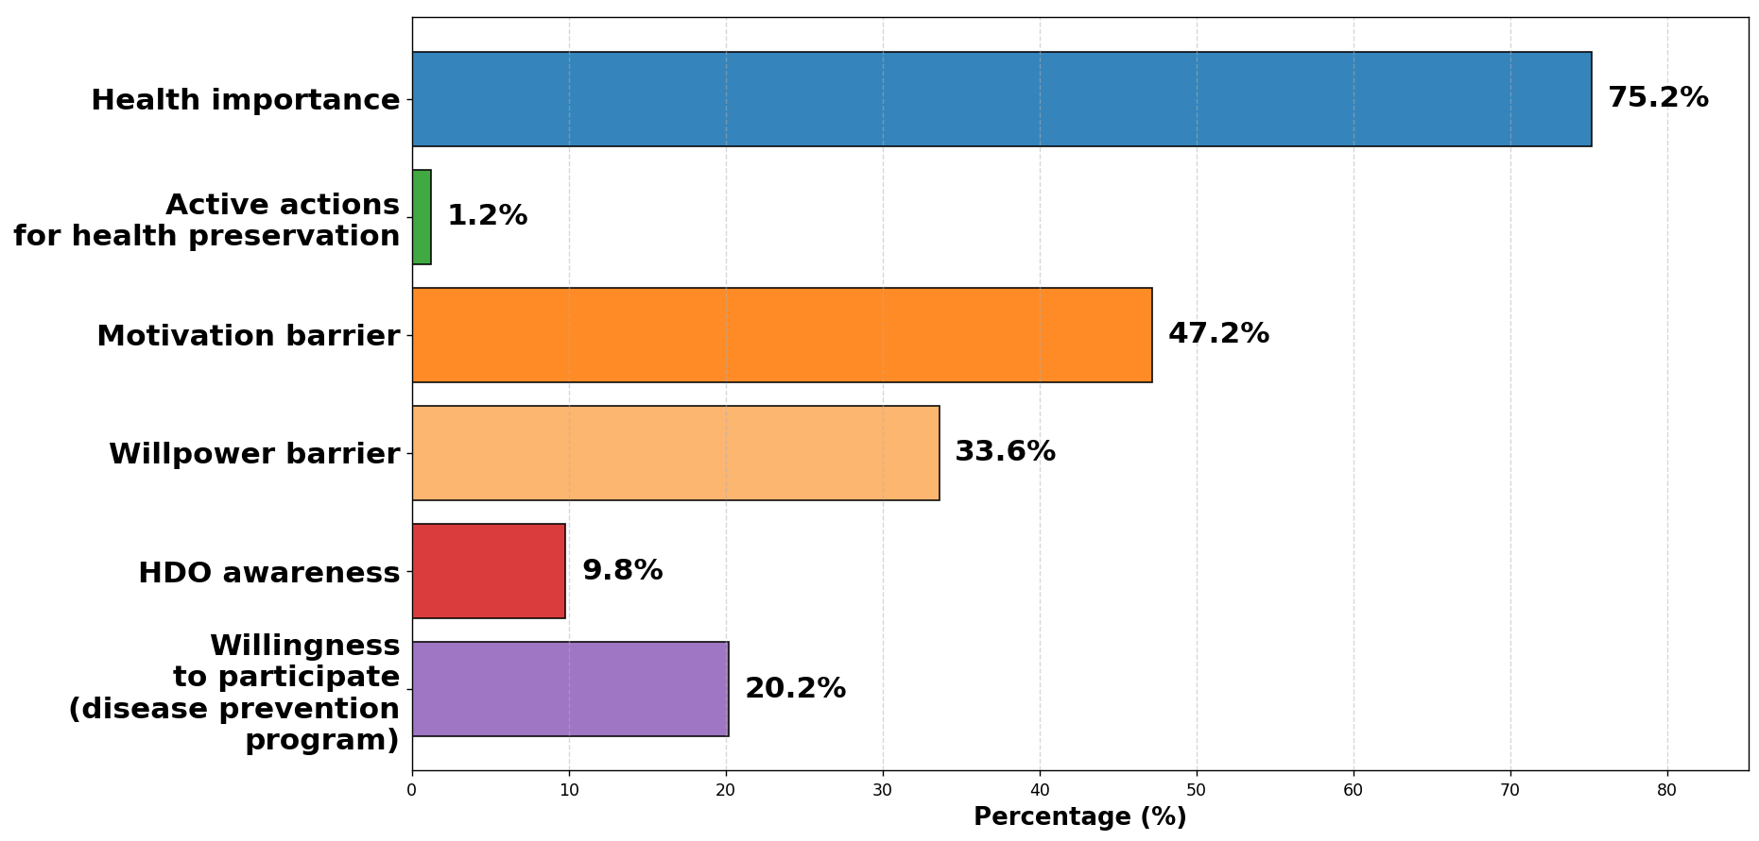


Assessment of Awareness of the Health Development Office and the Barriers to Utilizing Preventive Health Services among Older Patients (60+) of the Újbuda Szent Kristóf Outpatient Clinic
Péter Domján¹, Viola Angyal², Dr. Ádám Bertalan³, Iván Petrov⁴, Dr. István Vingender⁵
¹ ² ³ Semmelweis University, Doctoral College, Health Sciences Division
⁴ Semmelweis University, Heart and Vascular Centre
⁵ Semmelweis University Faculty of Health Sciences, Department of Social Sciences
INTRODUCTION
RESULTS
Disease prevention and quality-of-life maintenance in an ageing society are key public health priorities in Hungary.
Health Development Offices (HDOs) play an important role in supporting health promotion among older adults; however, they remain relatively unknown, and their use is limited by several factors. HDOs provide services in mental health, nutrition, and physical activity.
Figure 1. Key Findings on Health Attitudes among older adults (n=500)
AIMS
Among respondents (n=500), 60.4% were women and 39.6% men, mostly residents of District XI (93.6%). The majority were retired (87.4%) and highly educated (77% held higher education degrees). Wilcoxon rank test confirmed a significant gap between perceived importance of health preservation and actual actions (Z = -18.94; p < 0.001). Psychological and motivational barriers were the main obstacles, while awareness of the Health Development Office remained very low (9.8%).
We conducted a cross-sectional questionnaire survey (n=500) among residents aged 59 and over in District XI of Budapest at the Újbuda St. Kristóf Outpatient Care Centre. The survey examined socio-demographic background, lifestyle, health status, barriers to health maintenance, and awareness and willingness to use Health Development Office (HDO) services.
METHODS
CONCLUSION
Data were analyzed using descriptive statistics, cross-tabulation, and cluster analysis. A non-random convenience sampling method was applied. Data collection took place between July 1 and October 30, 2025, with the assistance of an interviewer, and analyses were performed in SPSS 28.0 using the Wilcoxon rank test. Ethical approval number: 9/2024 (Dél-Budai Centrumkórház, Szent Imre Kórház).
The results indicated that while awareness of the importance of health maintenance is widespread among older adults, active engagement in health-promoting behaviors lags significantly behind this attitude. In this age group, the main barriers to primary prevention are psychological and motivational in nature. Widespread communication is needed for better outcomes.
SUPPORTED BY THE 2024-2.1.2-EKÖP-KDP-2024-00002 UNIVERSITY RESEARCH SCHOLARSHIP PROGRAMME OF THE MINISTRY FOR CULTURE AND INNOVATION FROM THE SOURCE OF THE NATIONAL RESEARCH,
DEVELOPMENT AND INNOVATION FUND

