Slide 1
Adaptive Bayesian Learning Framework with Precision Entropy Indicator for Biomedical Decision Support
Biomedical Data Science Conference 2025
Semmelweis University, Budapest, Hungary
Domján Péter, Angyal Viola, dr. Bertalan Ádám, dr. Vingender István
dr. Dinya Elek
Doctoral College,
Health Sciences Division,
Interdisciplinary Applied Health Sciences Program
07/08/2025

Slide 2
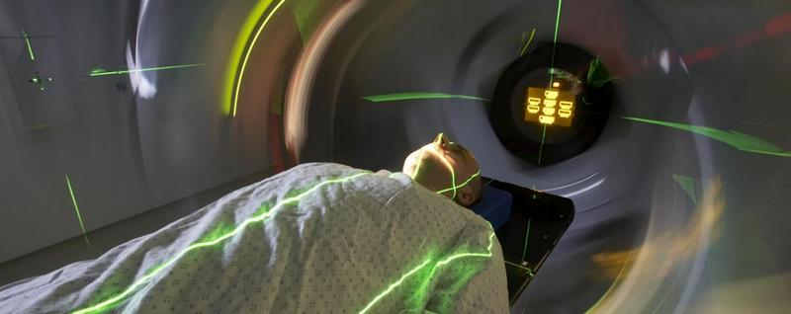
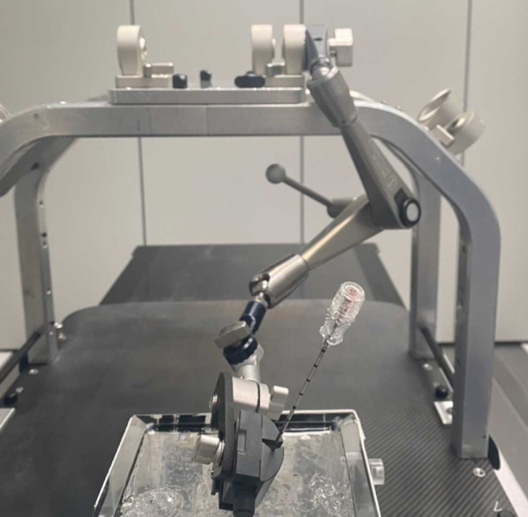
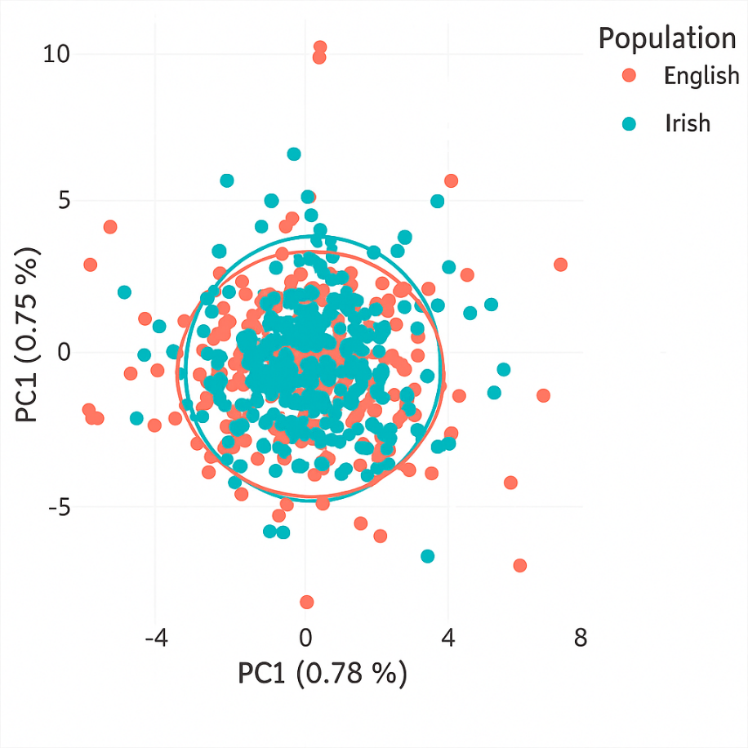

Slide 3
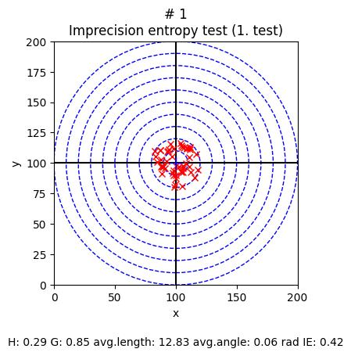
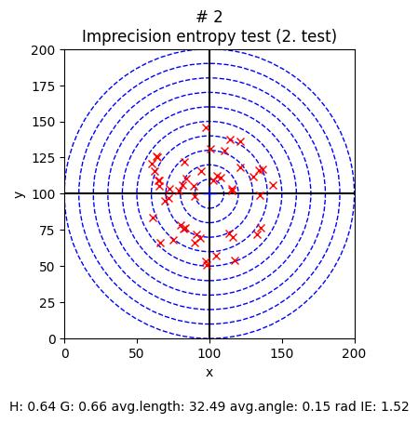
?

Slide 4
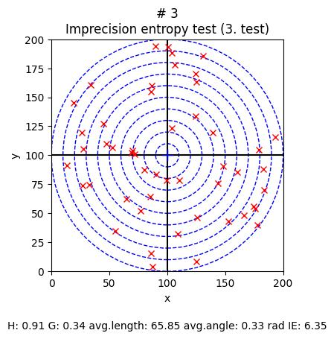
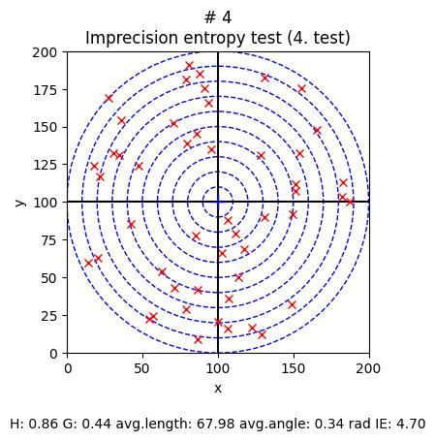
?

Slide 5

Kazimir Malevich: Black Square on a White Background (1915)

Slide 6

Julie Mehretu: Stadia II (2004)

Slide 7
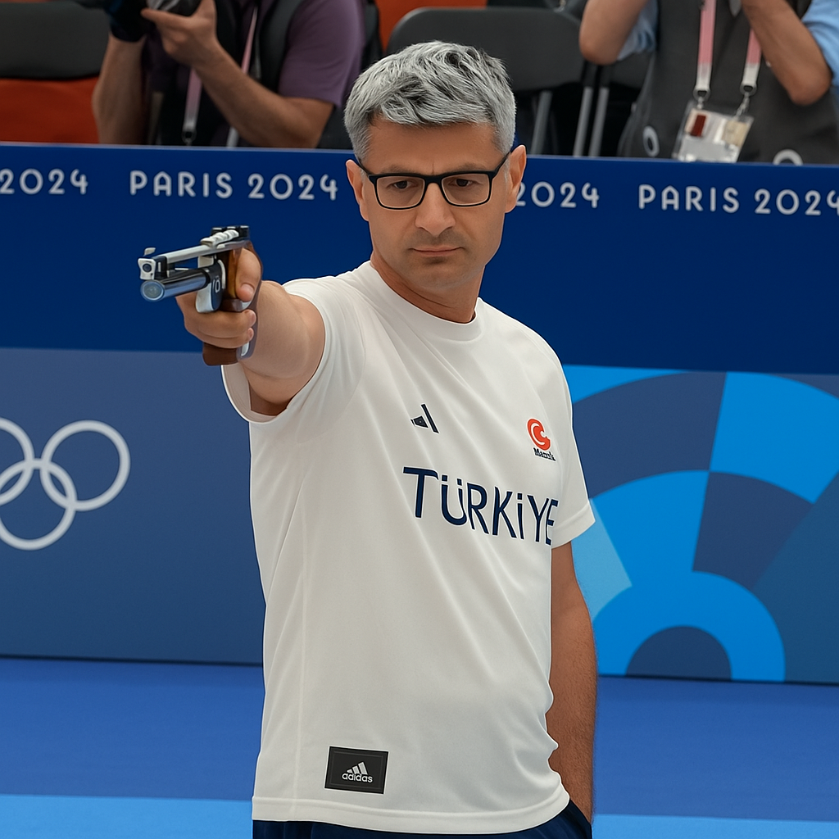
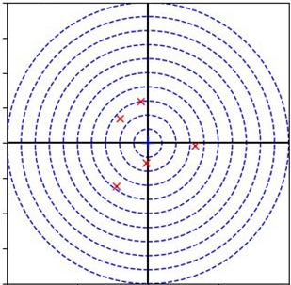
Uncertainty is high

Slide 8
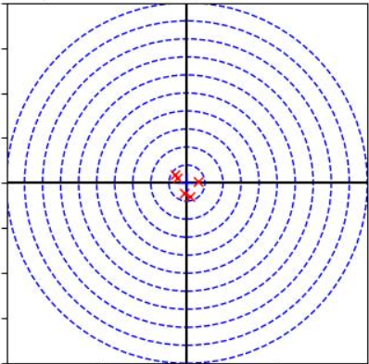
Uncertainty is low

Slide 9
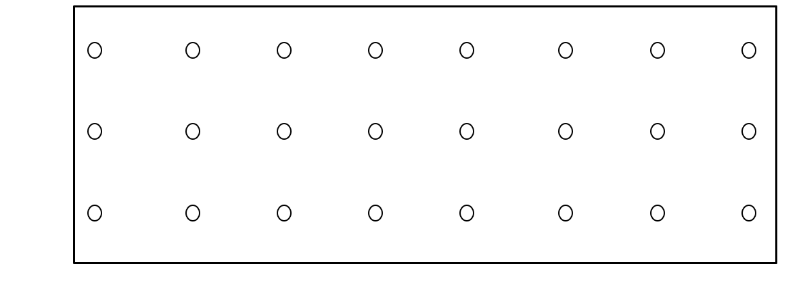

G (Concentration) = low
H (Uncertainty) = high
$$\frac{H}{G}$$

Slide 10
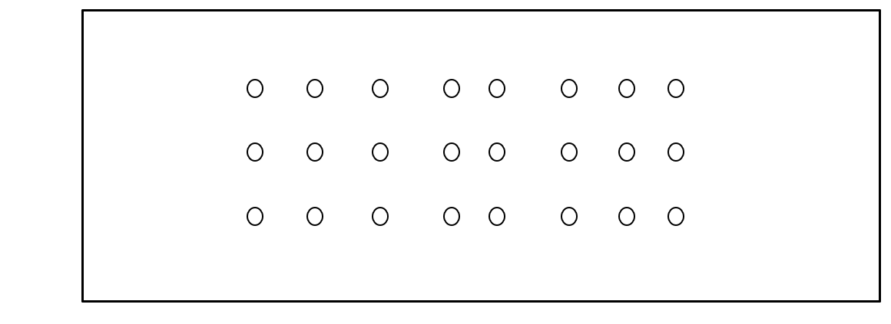
G (Concentration)
H (Uncertainty)
$$\frac{H}{G}$$

Slide 11
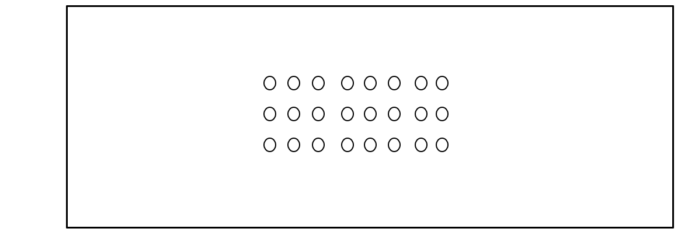
G (Concentration)
H (Uncertainty)
$$\frac{H}{G}$$

Slide 12
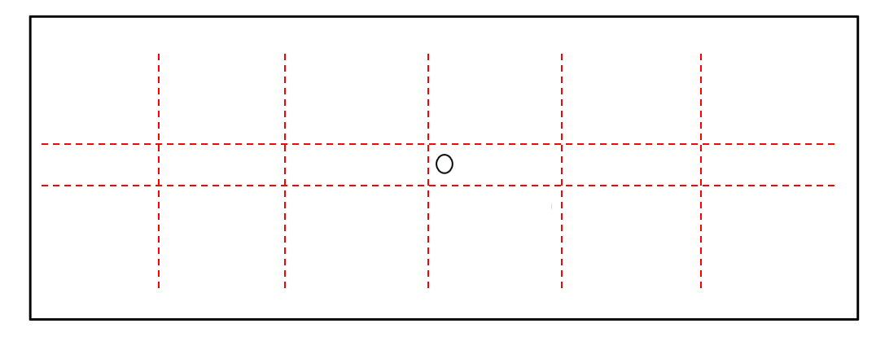
G (Concentration)
H (Uncertainty)
$$\frac{H}{G}$$

Slide 13
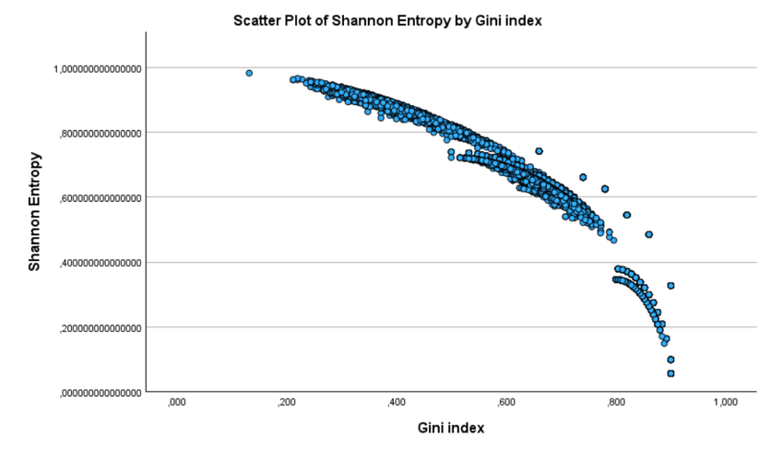
n=81,000

Slide 14
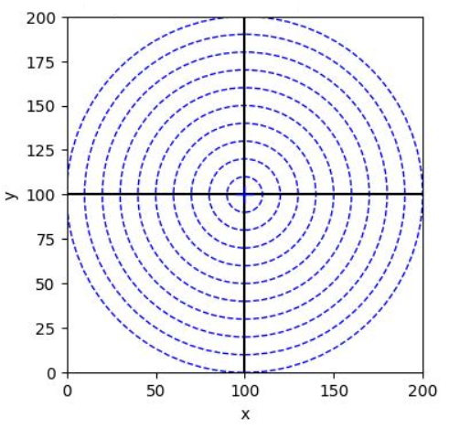
The aim is for the search algorithm to locate the 10-radius target area from any starting point within the 100-radius circle by performing search steps, with a total of 1,000 successful target searches to be achieved.

Slide 15
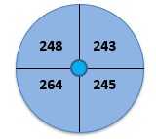
Random Search
Target Zone
1,000 successful target hits
10,341 search steps

Slide 16
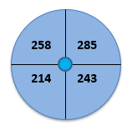
Random Walking Search
Target Zone
1,000 successful target hits
114,425 search steps

Slide 17
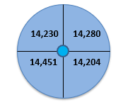
Genetic Search
Target Zone
1,000 successful target hits
574,131 search steps

Slide 18
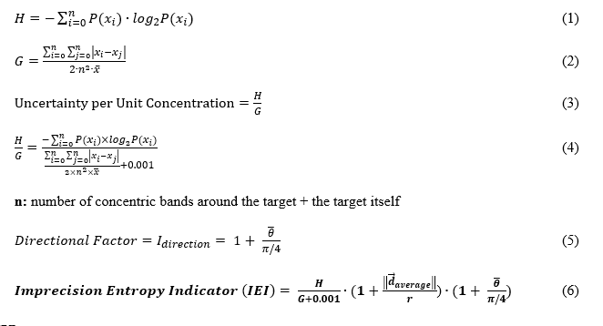

Slide 19
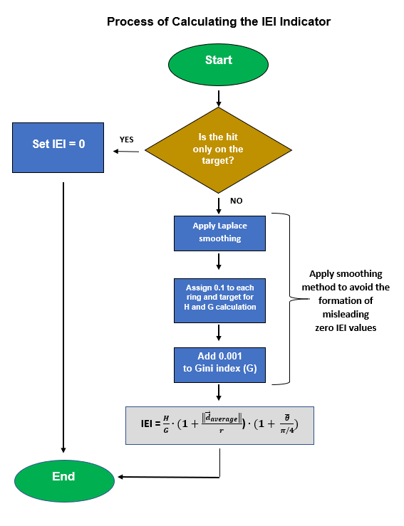

Slide 20
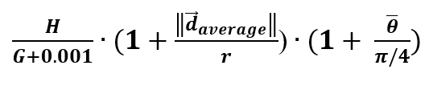



IEI =
$$\frac{H}{G}$$
This illustrates the spatial extension of Shannon entropy.
Imprecision Entropy Index

Slide 21

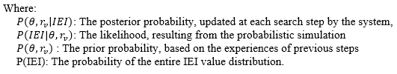
Bayesian Adaptive System

Slide 22
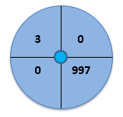
Bayesian Adaptive Search Algorithm
Target Zone
1,000 successful target hits
8,867 search steps

Slide 23
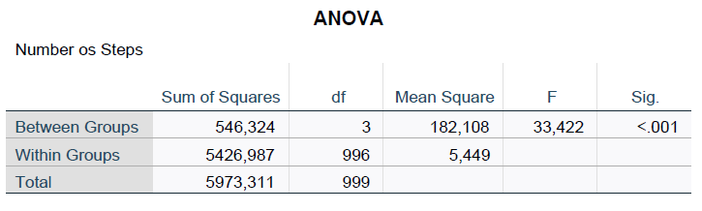
Entropy Field Distortion

Slide 24
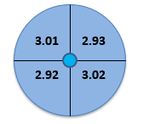
Weighted Average IEI Values
Target Zone

Slide 25
Density function of the posterior values
In total: 7,867 × 40 = 314,680 posterior values were analyzed.

Slide 26
Posterior cumulative distribution function (CDF)
In total: 7,867 × 40 = 314,680 posterior values were analyzed.

Slide 27
Summary
Mapping of the target area (entropy field) was performed using 12,000 measurement points (IEI values).
A total of 4,000 measurements and 707,764 steps were analyzed in the control studies.
Bayesian search algorithm (8.86 steps)* Random search (10.34 steps)* Random walk search (114.42 steps)* Genetic search algorithm (574.13 steps)*
The entropy field is maximal and homogeneous as long as there is no (observed) designated target direction.
The presence of a target direction causes entropy field distortion, which affects search efficiency.
Deviation from the target is caused by the uncertainty inherent in the system. By reducing uncertainty lim_{x→0}, we can reach the state of perfect targeting.

Slide 28

Summary
The distortion of the entropy space affects the number of search steps. By taking uncertainty patterns into account, the research time can be reduced.
The Bayesian adaptive search system successfully found the target by reducing uncertainty (IEI), based on 314,680 posterior data points.
In addition to healthcare applications, these results may also be linked to quantum physical phenomena, such as the double-slit experiment.
The entropy field surrounds our lives, and mapping it can influence the outcomes of individual research studies.

Slide 29
Understanding and measuring the uncertainty behind pattern concentration (cause),
rather than just focusing on the outcome (effect),
enables us to significantly reduce search and research time.
We know the underlying cause, we can find the right answers much faster.

Slide 30
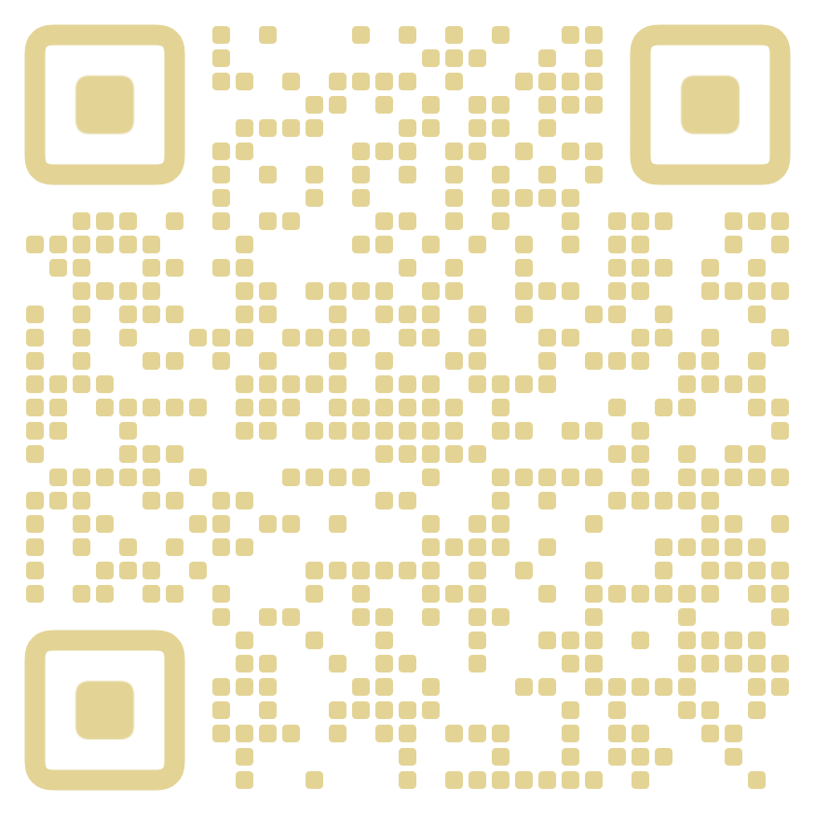
Thank you for your attention!
www.gerontosociology.com
domjan.peter@phd.semmelweis.hu

