Slide 1
Validating Pre- and Post-Intervention
Questionnaires
for Elderly Promotion in Újbuda
PhD Scientific Days 2025
Semmelweis University
Domján Péter, Angyal Viola, dr. Bertalan Ádám, dr. Vingender István
Doctoral College,
Health Sciences Division,
Interdisciplinary Applied Health Sciences Program
07/07/2025

Slide 2
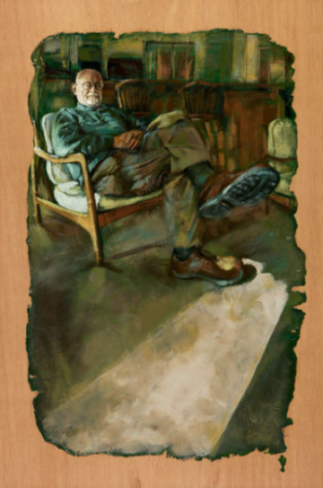
„Father”
Becca Bernstein and
Gwenn Seemel
(2009-2010)
https://gwennseemel.com/artwork/subjective/richard/

Slide 3

„Father”
Becca Bernstein and
Gwenn Seemel
(2009-2010)
https://gwennseemel.com/artwork/subjective/richard/

Slide 4
DISEASE PREVENTION
HEALTH AND CONDITION MAINTENANCE
Attitude Change

Slide 5



Health Development Office (HDO)
DIETETITIAN
PHYSIOTHERAPIST
MENTAL HEALTH SPECIALIST
The aim is to popularize primary and secondary prevention.

Slide 6


Slide 7
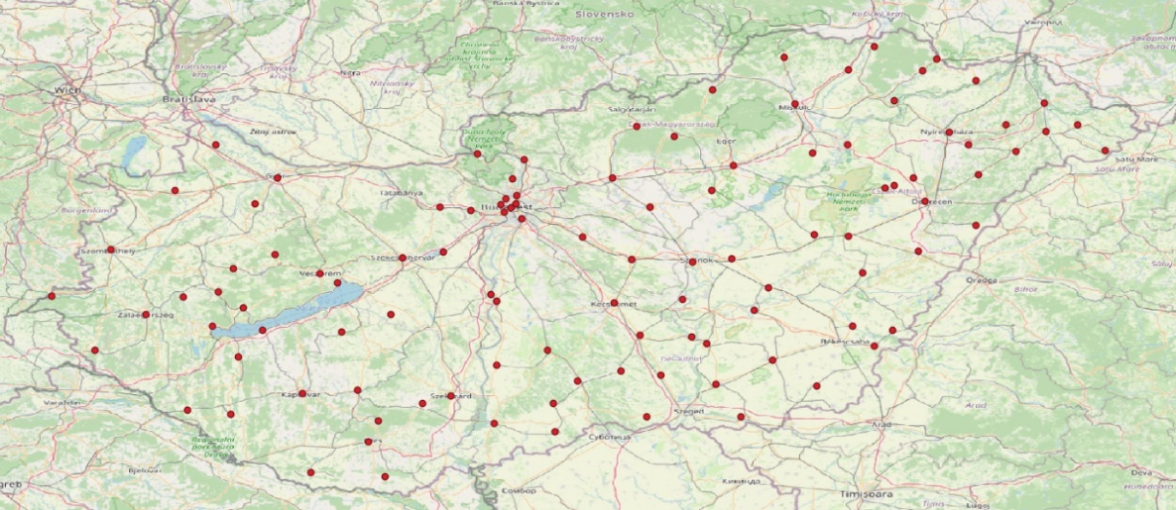
Health Development Offices in Hungary
Based on data from NNGYK, visualized with QGIS software, January 2024 (N=108)

Slide 8
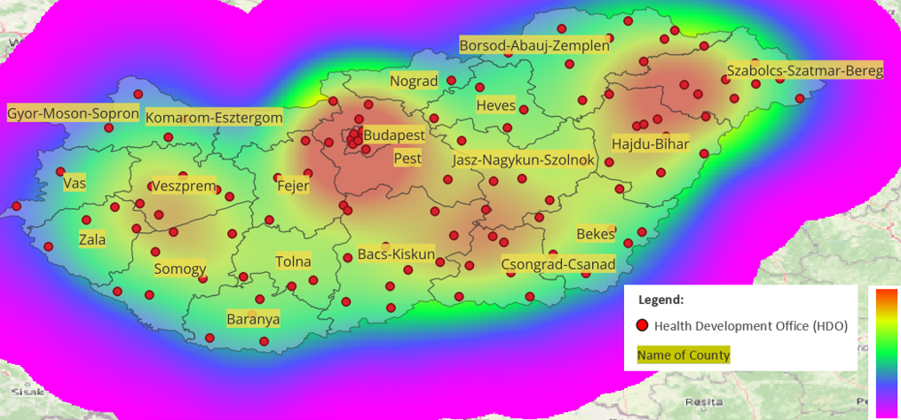
Distribution of Health Development Offices (HDO)
Analyzed with Kernel Density Estimation
QGIS software, based on NNGYK data, 01.2024 (N=108; number of HDOs)

Slide 9
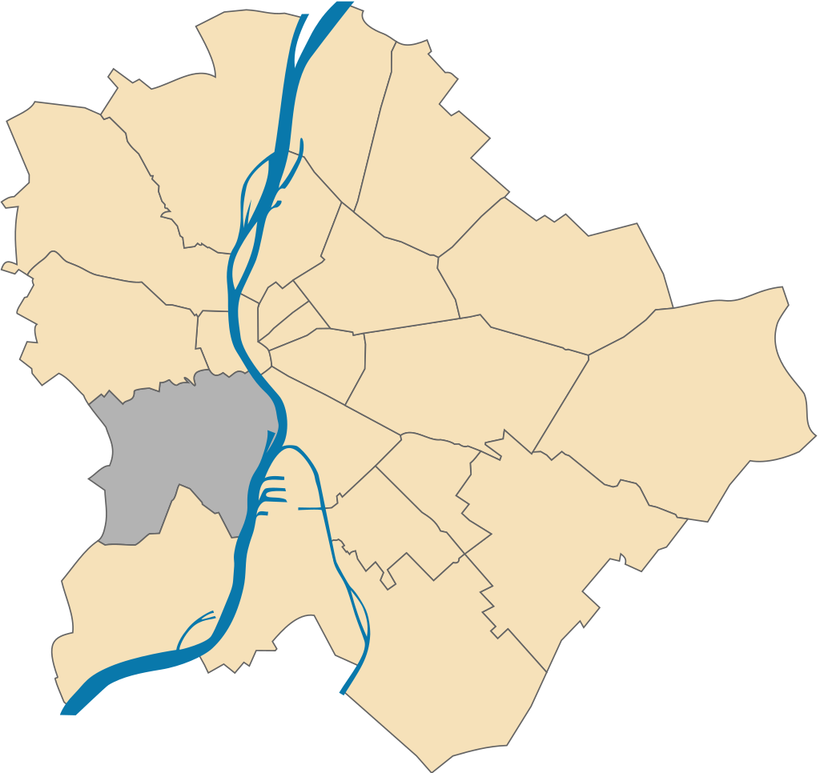
Újbuda

Slide 10
Questionnaire Validation
Content Validity Analysis
Expert review:
statistician, psychologist, sociologist, individuals aged 60 and over
Reliability Testing (test–retest)
Internal consistency (Cronbach’s Alpha)
Test-retest reliability (ICC)
Pearson correlation

Slide 11

Test n=25; Retest n=25
Health Prevention Attitude Survey
New HDO Clients (PRE)
Health Prevention Attitude Survey
Past HDO Clients from 2019
Health Prevention Attitude Survey
Returning HDO Clients (POST)
Survey of Health Development Service Needs
Test n=50; Retest n=50
Test n=25; Retest n=25
Test n=100
PAST
PRESENT
FUTURE
$\sum{n}$=300

Slide 12
Inclusion Criteria (Past)
Age: 60 years or older
Participation in the 6-session preventive program provided by the Health Development Office (HDO) at least once in 2019
Test-retest reliability was assessed
Participation is voluntary and anonymous

Slide 13
Inclusion Criteria (PRE-POST; Present)
Age: 60 years or older
First time participating in the HDO (Health Development Office) preventive service
The participant meets the participation requirements of the prevention program
Participation is voluntary and anonymous
Test and retest

Slide 14
Inclusion Criteria (Future)
Age: 60 years or older
The questionnaire survey was conducted at the Újbuda Szent Kristóf Outpatient Care Centre
Participation is voluntary and anonymous

Slide 15
Sociodemographic Section

Slide 16
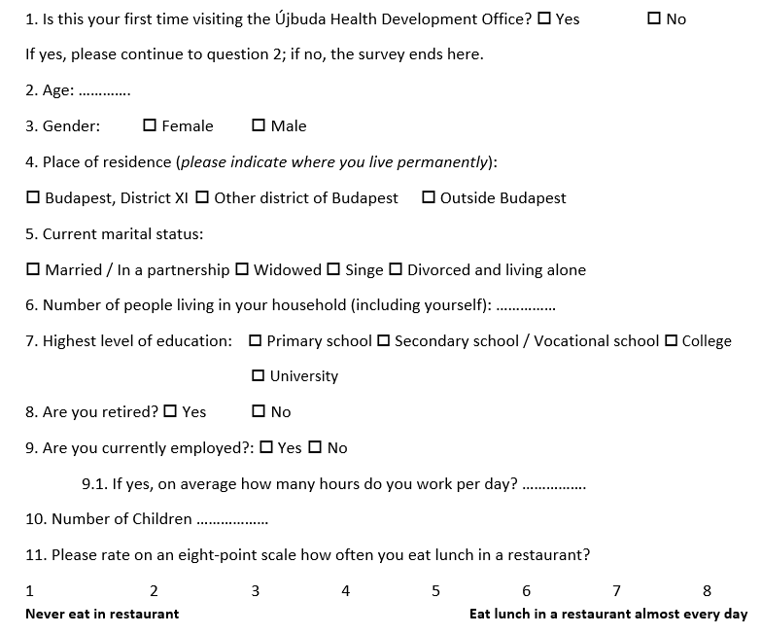
Sociodemographic Section

Slide 17
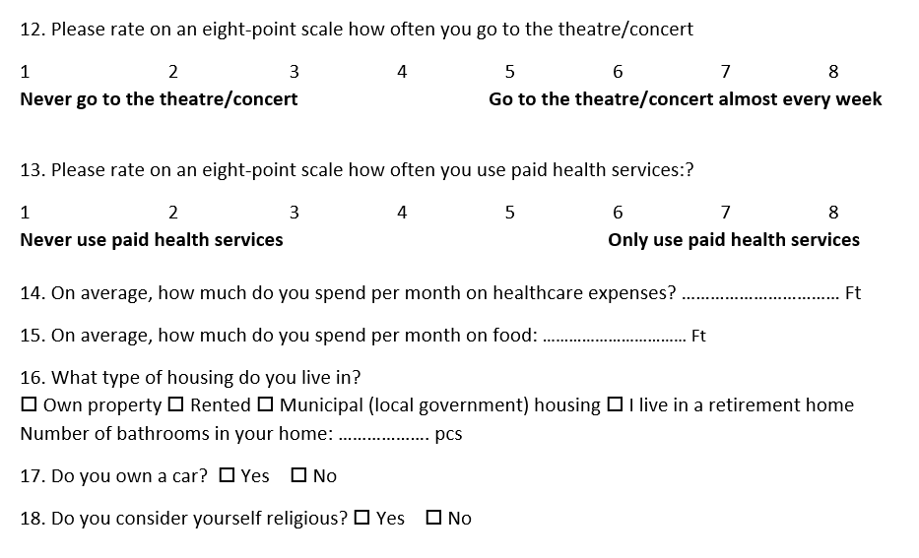
Sociodemographic Section

Slide 18

PRE; Present; $n_{1}=25 ;n_{2}=25$
Indicator | Category | Score | Value (HUF/month)
Place of residence | Budapest, District XI | 1 | 60 000 Ft
 | Other districts of Budapest | 2 | 60 000 Ft
 | Outside Budapest | 3 | 30 000 Ft
Highest education | University | 4 | 150 000 Ft
 | College | 3 | 100 000 Ft
 | Secondary school / Vocational school | 2 | 50 000 Ft
 | Primary school | 1 | 20 000 Ft
Marital status | Married / In a partnership | 2 | 50 000 Ft
 | Divorced / Single / Widowed | 1 | 20 000 Ft
Employment status | Yes (full-time ≥6 hours) | 1 | 150 000 Ft
 | Yes (part-time <6 hours) | 1 | 80 000 Ft
 | Not working | 2 | 0 Ft
Restaurant visits | 6-8 (frequently) | 3 | 70 000 Ft
 | 4-5 (occasionally) | 2 | 40 000 Ft
 | 1-3 (rarely/never) | 1 | 10 000 Ft
Theatre/concert visits | 6-8 (frequently) | 3 | 60 000 Ft
 | 4-5 (occasionally) | 2 | 30 000 Ft
 | 1-3 (rarely/never) | 1 | 5 000 Ft
Paid health services | 6-8 (only paid services) | 3 | 100 000 Ft
 | 4-5 (mixed services) | 2 | 50 000 Ft
 | 1-3 (does not use) | 1 | 10 000 Ft
Type of housing | Own property | 1 | 50 000 Ft
 | Rented | 2 | 25 000 Ft
 | Municipal/Retirement home | 3 | 10 000 Ft
Own car | Yes | 1 | 50 000 Ft
 | No | 2 | 0 Ft
Estimated income (HUF) =
sum of indicator values (HUF)
+
total healthcare expenses
+
total food expenses
Average income (test): 363 866 Ft
Average income (retest): 377 150 Ft

Slide 19

Consistency Between Measurements
(test vs. retest)
PRE; Present; $n_{1}=25 ;n_{2}=25$
Question items | ICC | p |  | Correlation
2 | 1 | <0,05 |  | 1
6 | 0,992 | <0,05 |  | 0,985
7 | 1 | <0,05 |  | 1
9.1 | - | - |  | -
10 | 0,983 | <0,05 |  | 0,968
11 | 0,923 | <0,05 |  | 0,858
12 | 0,928 | <0,05 |  | 0,866
13 | 0,915 | <0,05 |  | 0,872
14 | 0,913 | <0,05 |  | 0,85
15 | 0,956 | <0,05 |  | 0,917
16.1 | 1 | <0,05 |  | 1

Slide 20
PRE; Present; $n_{1}=25 ;n_{2}=25$
Health Prevention, Health Values, and Health Attitude Items

Slide 21
Internal Consistency (PRE survey)
PRE; Present; $n_{1}=25 ;n_{2}=25$
How important is your health to you?
How important is health maintenance to you (nutrition, lifestyle, physical activity, mental health)?
In your opinion, to what extent do you strive to maintain your health?
How important is regular physical activity to you?
How important is healthy nutrition to you?
How important is mental health to you?
What is your attitude towards preventive health screenings?
Information regarding attitudes towards visiting the general practitioner.
To what extent do you pay attention to your diet?
In the future, to what extent do you intend to devote time to your health?
How would you rate current health status?
ICC value 0.859
(95% CI: 0.740–0.940; p < 0.05),
indicating the temporal stability and coherence of the scale items.

Slide 22
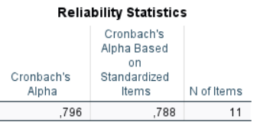
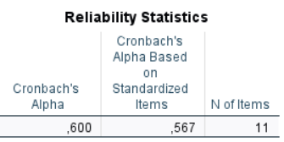
Reliability (Cronbach’s Alpha)
PRE; Present; $n_{1}=25 ;n_{2}=25$
TEST
RETEST
Physical Activity, screening examinations,

Slide 23


Consistency Between Measurements
(test vs. retest)
PRE; Present; $n_{1}=25 ;n_{2}=25$
Item number | ICC | p |  | Correlation
1 | 0,893 | <0,05 |  | 0,841
2 | 0,851 | <0,05 |  | 0,809
3 | 0,772 | <0,05 |  | 0,636
4 | 0,91 | <0,05 |  | 0,845
5 | 0,905 | <0,05 |  | 0,827
6 | 0,846 | <0,05 |  | 0,783
7 | 0,818 | <0,05 |  | 0,694
8 | 0,919 | <0,05 |  | 0,855
9 | 0,823 | <0,05 |  | 0,73
10 | 0,959 | <0,05 |  | 0,922
11 | 0,882 | <0,05 |  | 0,793

Slide 24
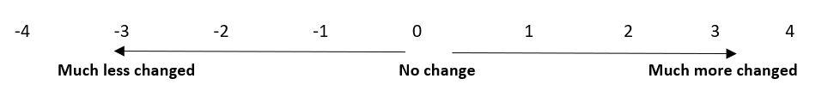

Internal Consistency (POST survey)
POST; Present;; $n_{1}$= 25 ; $n_{1}$= 25
To what extent has your health become more or less important to you?
Has your attitude toward health maintenance (health prevention) changed?
To what extent do you feel you can influence your health?
In your opinion, how important is regular physical activity for maintaining health?
In your opinion, how important is healthy nutrition for maintaining health?
In your opinion, how important is mental health for maintaining health?
Has your attitude toward preventive health screenings changed?
In what direction and to what extent has your attitude toward healthy
nutrition changed?
Has your attitude toward physical activity changed?
In the future, to what extent do you intend to devote time to maintaining
your health?
ICC value 0.940
(95% CI: 0.899–0.970;
p < 0.05),
Indicating the temporal stability and coherence of the scale items.

Slide 25
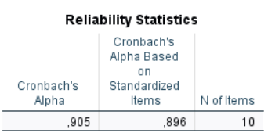
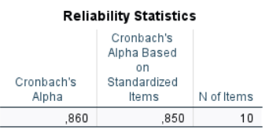

Reliability (Cronbach’s Alpha)
POST; Present;; $n_{1}$= 25 ; $n_{1}$= 25
TEST
RETEST
Health screening, physical activity,

Slide 26

Consistency Between Measurements
(test vs. retest)
POST; Present;; $n_{1}$= 25 ; $n_{1}$= 25
Item number | ICC | p |  | Correlation
1 | 0,874 | <0,05 |  | 0,779
2 | 0,939 | <0,05 |  | 0,887
3 | 0,998 | <0,05 |  | 0,996
4 | 0,943 | <0,05 |  | 0,895
5 | 0,954 | <0,05 |  | 0,918
6 | 0,912 | <0,05 |  | 0,84
7 | 0,947 | <0,05 |  | 0,91
8 | 0,889 | <0,05 |  | 0,805
9 | 0,844 | <0,05 |  | 0,735
10 | 0,844 | <0,05 |  | 0,795

Slide 27
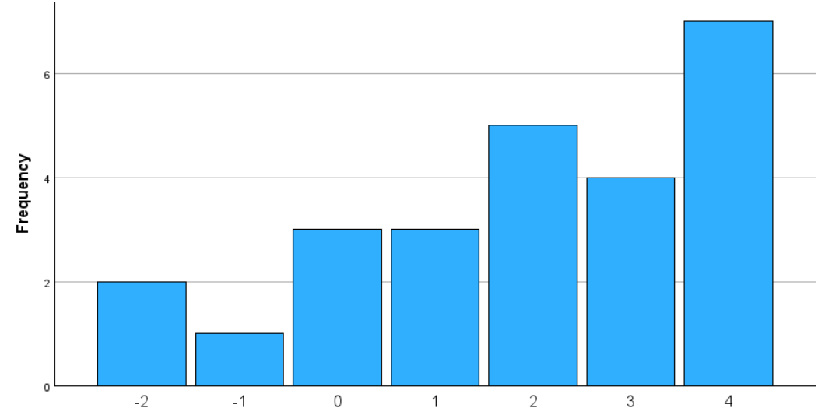
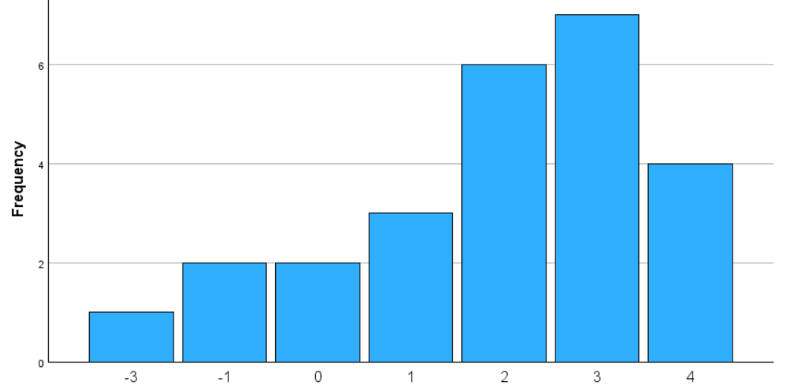

2. Has your attitude towards health maintenance
(disease prevention) changed?
POST; Present;; $n_{1}$= 25 ; $n_{1}$= 25
Test
Retest

Slide 28
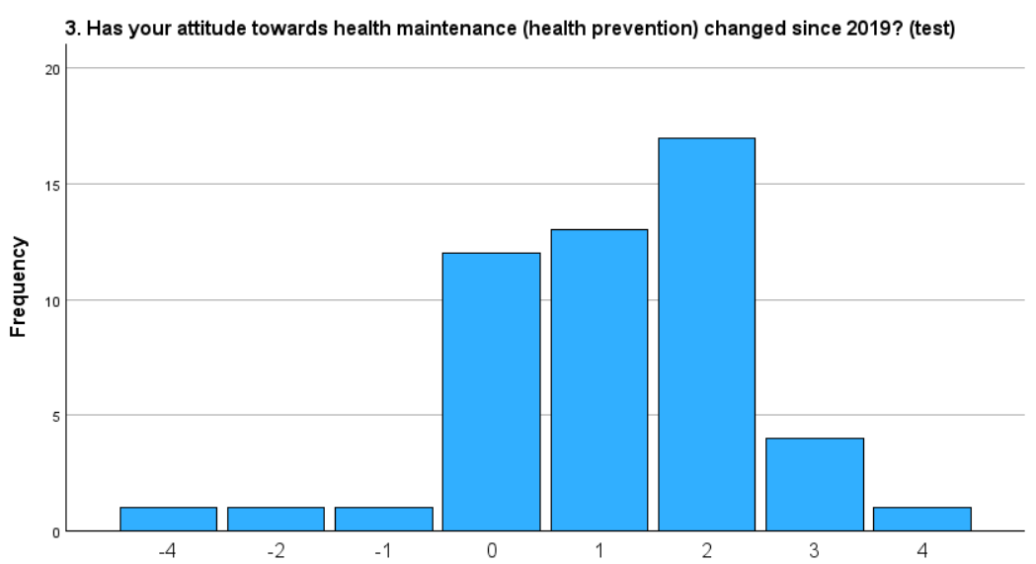

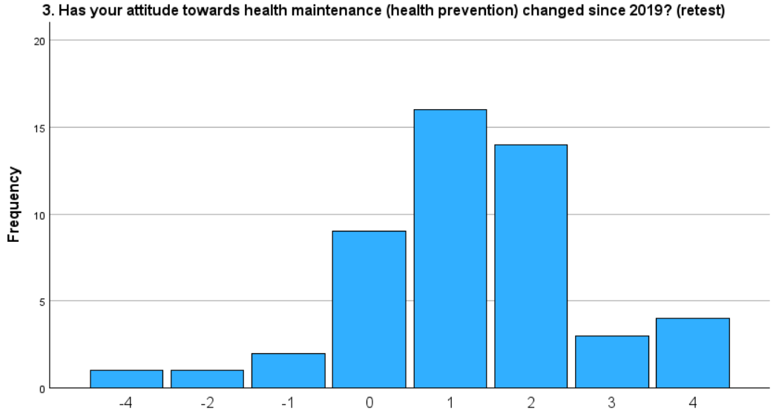

Consistency Between Measurements
(test vs. retest)
Past; $n_{1}=50 ;n_{2}=50;$
$$test −retest$$
Item number | ICC | p |  | Correlation
1a | 0,931 | <0,05 |  | 0,869
1b | 0,953 | <0,05 |  | 0,976
1c | 0,956 | <0,05 |  | 0,977
2 | 0,913 | <0,05 |  | 0,847
3 | 0,946 | <0,05 |  | 0,903
4 | 0,903 | <0,05 |  | 0,946
5_1 | 0,953 | <0,05 |  | 0,921
5_2 | 0,86 | <0,05 |  | 0,915
5_3 | 0,924 | <0,05 |  | 0,867
6 | 0,873 | <0,05 |  | 0,776
7 | 0,966 | <0,05 |  | 0,933
8 | 0,872 | <0,05 |  | 0,772
9 | 0,838 | <0,05 |  | 0,718
9_1 | 0,963 | <0,05 |  | 0,93
10 | 0,948 | <0,05 |  | 0,906
11a | 0,807 | <0,05 |  | 0,676
11b | 0,7 | <0,05 |  | 0,534
11c | 0,914 | <0,05 |  | 0,842
11d | 0,879 | <0,05 |  | 0,781
11e | 0,926 | <0,05 |  | 0,861
11f | 0,89 | <0,05 |  | 0,8
12 | 0,914 | <0,05 |  | 0,854
13 | 0,987 | <0,05 |  | 0,976
14a | 0,904 | <0,05 |  | 0,822
14b | 0,822 | <0,05 |  | 0,698
14c | 0,935 | <0,05 |  | 0,875
test
retest

Slide 29
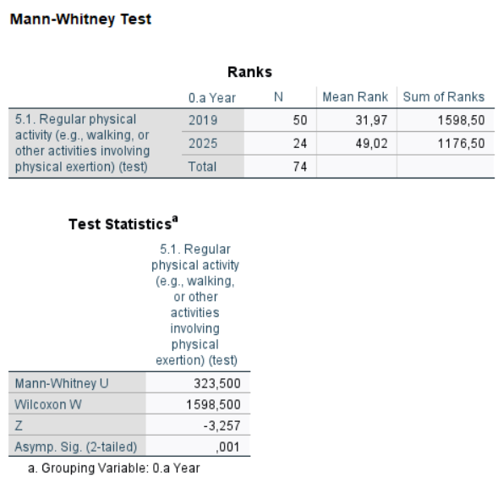
Past and Present n=74

Slide 30
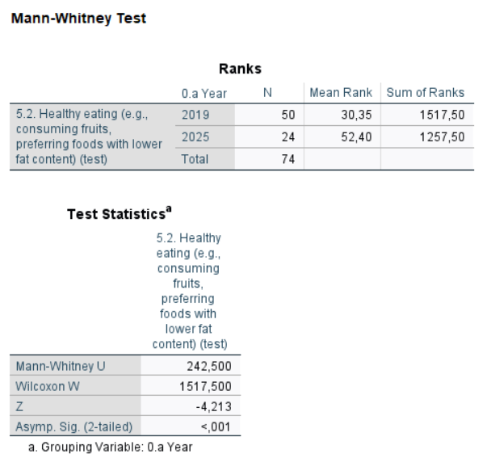
Past and Present n=74

Slide 31
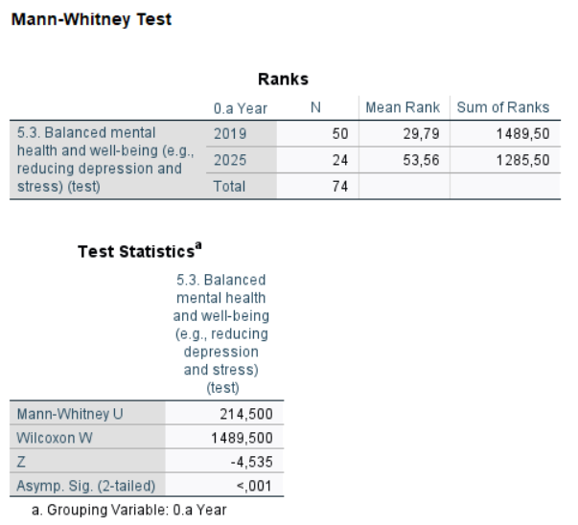
Past and Present n=74

Slide 32
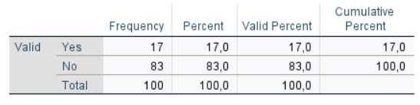
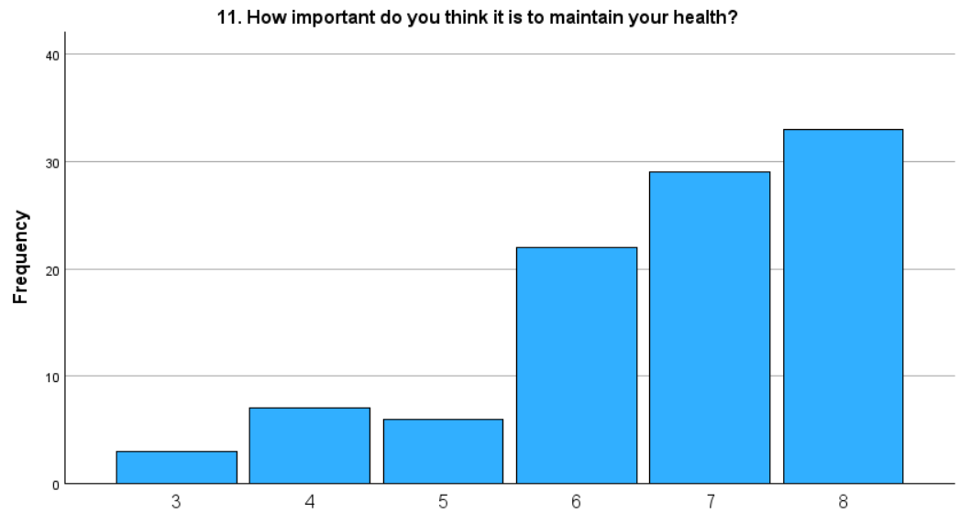
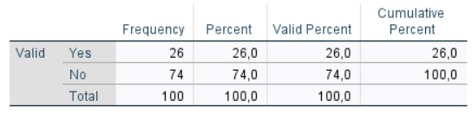
Health Preservation and HDO Program Participation in the Elderly
Future; n = 100
9. Have you heard about
the Újbuda Health Development Office
10. Would you participate in a health prevention program
provided by the Újbuda Health Development Office?

Slide 33
Summary
The internal consistency of the questionnaire (Cronbach’s Alpha) proved to be good during the test (α = 0.600 ... 0.905).
The temporal stability of the scales is supported by ICC values above 0.80.
During the test and retest, the examined questions showed a strong correlation (average 0.85).
Some questions (e.g., screening examination, general practitioner visits) showed low Pearson correlation; these items require further refinement.
Based on the results, the questionnaire is suitable for further testing and for the continued measurement of health behaviors among the elderly.
According to the Mann-Whitney U test (p<0.05), physical activity, nutrition, and well-being showed significant improvement between 2019 and now.

Slide 34
Health promotion remains a crucial factor in old age, as a positive change in attitude can save lives.
Key:
Enhancing individual and
social responsibility.

Slide 35


Thank you for your attention!
www.gerontosociology.com
domjan.peter@phd.semmelweis.hu
It was supported by the 2024–2.1.2-EKÖP-KDP- 2024–00002 University Research Scholarship Programme of the Ministry for Culture and Innovation from the source of the National Research, Development and Innovation Fund.

