Slide 1
The role of health development offices in PhD training and navigating crises in translational research
ORPHEUS 2025 Conference Adapting Academia: Navigating PhD Programs Amidst World Crises and Changes
Peter Domjan, Angyal Viola, Dr. Adam Bertalan, Dr. Istvan Vingender
Doctoral College,
Health Sciences Division,
Interdisciplinary Applied Health Sciences Programme
10/04/2025

Slide 2
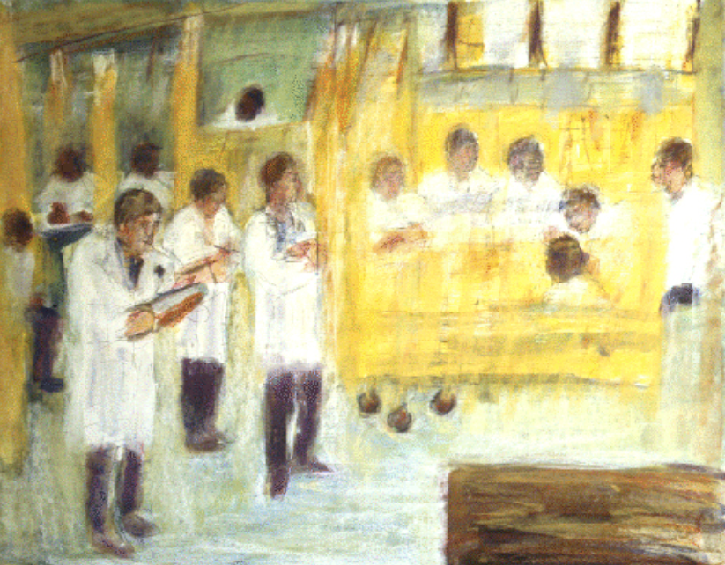
„Teaching Rounds at Charity” dr. May Hyman Lesser
(1960 – 1980)

Slide 3
Type of Crises in PhD Training
Methodological
Collaboration
Ethical
Resource
Implementation
Publication
Data Management
Time Management
Career
Mental
Inside Crises

Slide 4
Outside Crises
This image was generated using DALL·E by ChatGPT

Slide 5
It’s a possibility!
CRISIS SITUATION
RESOLUTION/SOLUTION

Slide 6
Health Development Office (HDO)
DIETITIAN
PHYSIOTHERAPIST
MENTAL HEALTH PROFESSIONAL,
PSYCHOLOGIST
The key is the Health Development Offices (HDO) as disease prevention service provider

Slide 8
Translational Research Process with HDOs
PhD STUDENT
HDOs
PhD RESEARCH

Slide 9
It’s a possibility!
PhD TRAINING
RESOLUTION/SOLUTION
HEALTH DEVELOPMENT OFFICE
The key is collaboration!

Slide 10
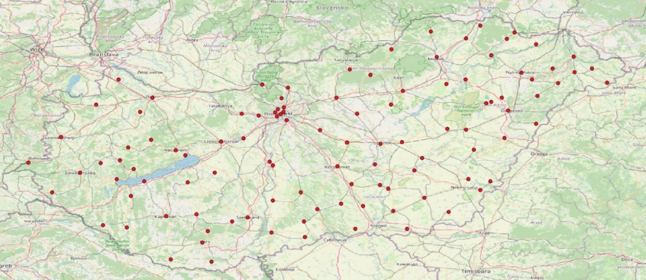
Geographical Placement of HDOs in Hungary
Analysis conducted with QGIS software based on NNK geodata, 01.2024 (N=108)

Slide 11
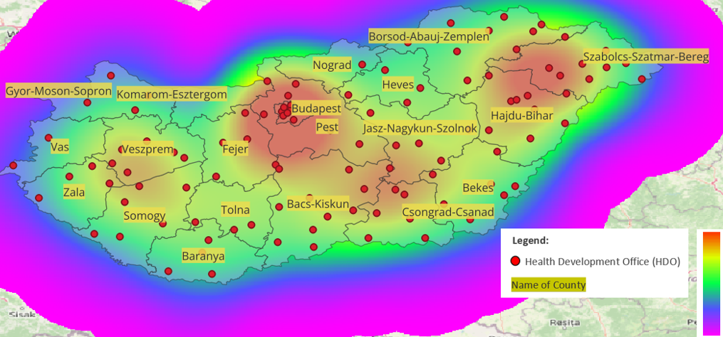
Heatmap of HDOs Kernel Density by County in Hungary
Analysis conducted with QGIS software based on NNK geodata, 01.2024 (N=108)

Slide 12
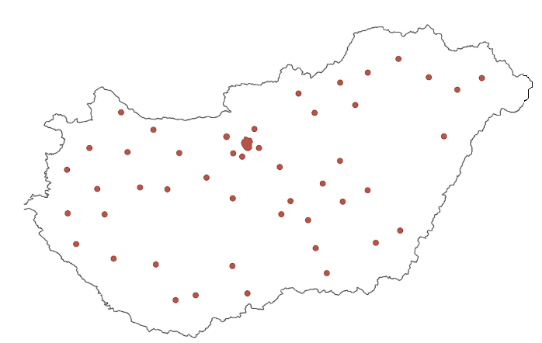
$$Gini−Coeficient (concentration)$$
$G=\frac{1}{2n^{2}\overline{x}}Σ_{i=1}^{n}Σ_{j=1}^{n}|x_{i}−x_{j}|$
Information about scatter plot.
$$H Shannon Entropy (uncertainty)$$
$H=−\sum_{i=1}^{n}{p_{i}}{×log}_{10}(p_{i}$)

Slide 13
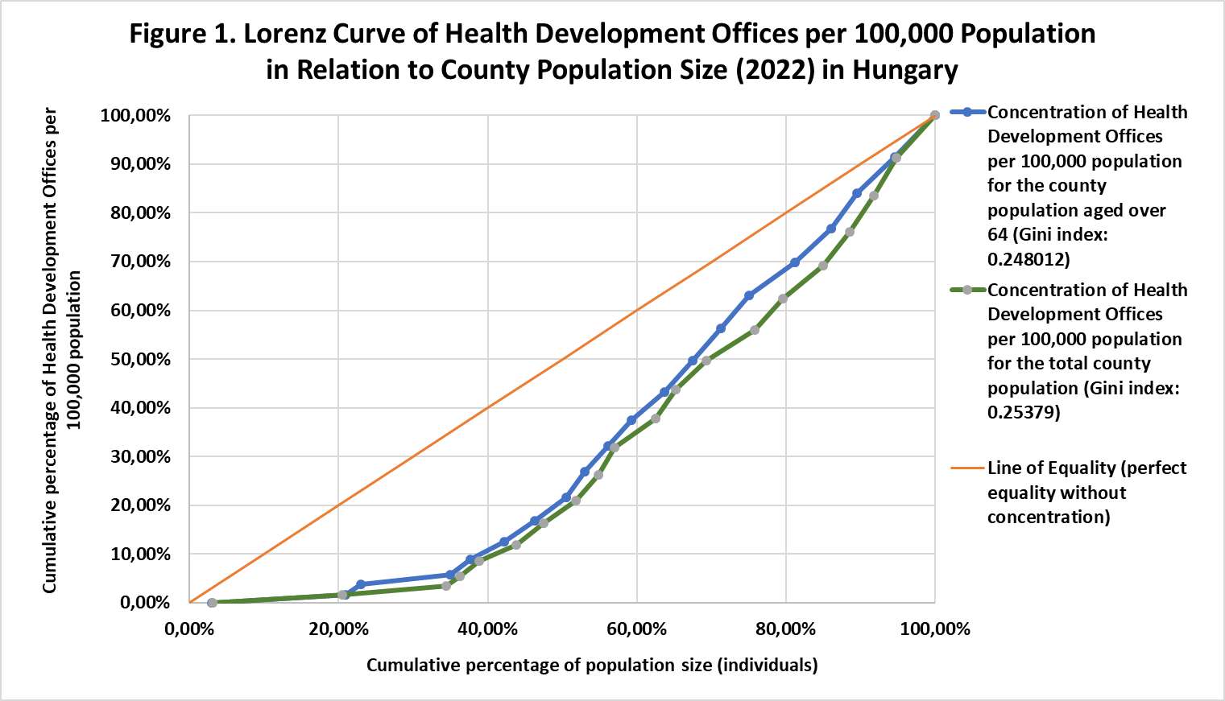
Data collected from 108 Health Development Offices (HDOs) across 19 counties and Budapest.

Slide 14
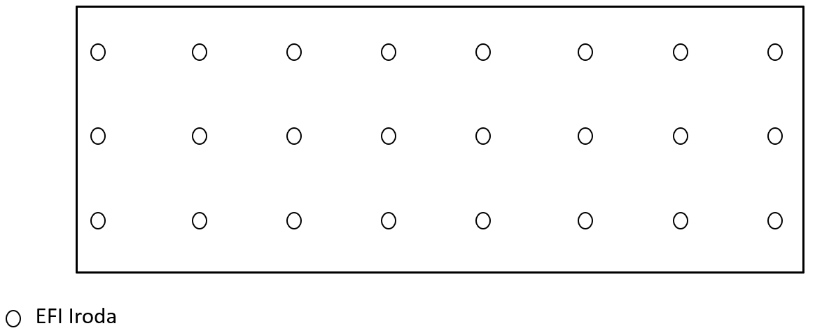
Health Development Office

Slide 15
G (Concentration) = low
H (Uncertainty) = high
Health Development Office
County Boundary

Slide 16
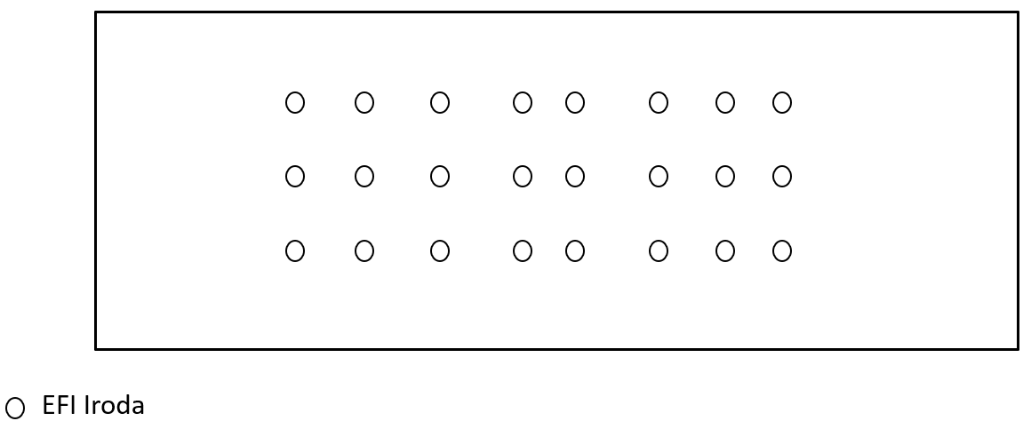
G (Concentration)
H (Uncertainty)
Health Development Office
County Boundary

Slide 17
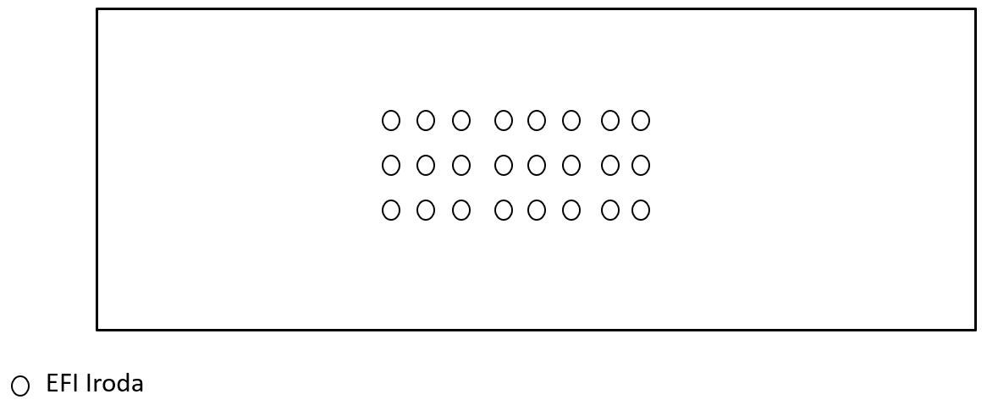
G (Concentration)
H (Uncertainty)
Health Development Office
County boundary

Slide 18
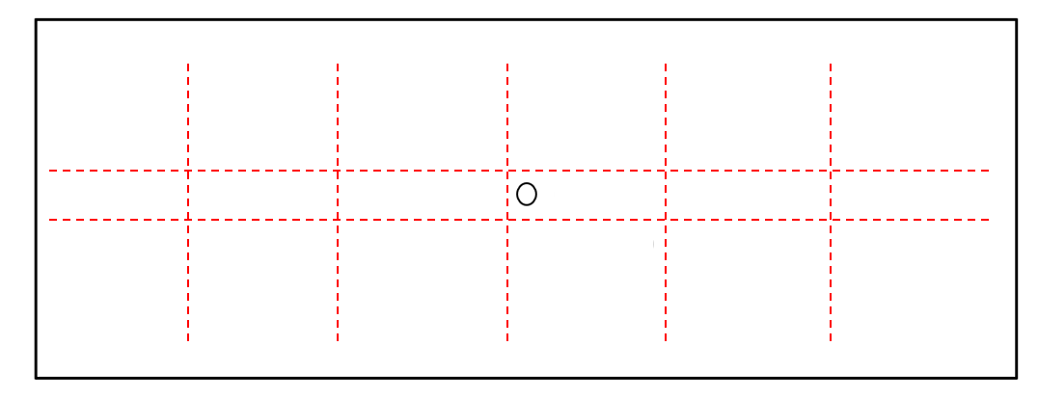
G (Concentration)
H (Uncertainty)
Health Development Office
County boundary

Slide 19
G (Concentration) = low
H (Uncertainty) = high
Health Development Office
County boundary

Slide 20
Uncertainty can also be assessed through the spatial distribution of the HDOs using:
H (Uncertainty): 1.24
G (Concentration): 0.24
Spatial dispersion of HDOs is suitable for nationwide collaboration in Hungary.

Slide 21
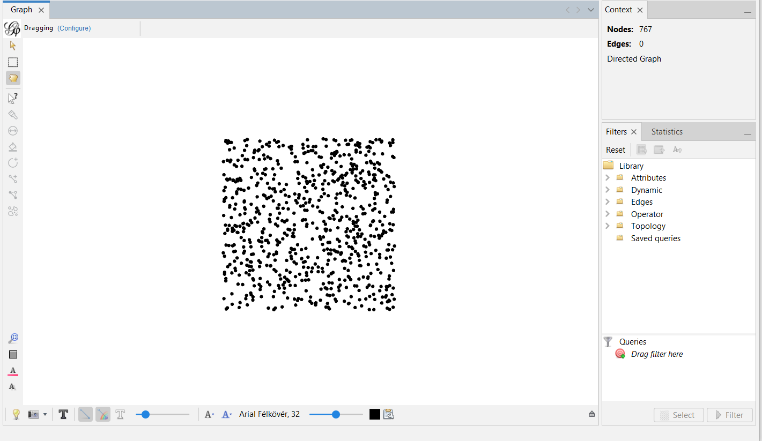
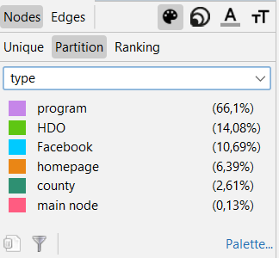

Slide 22
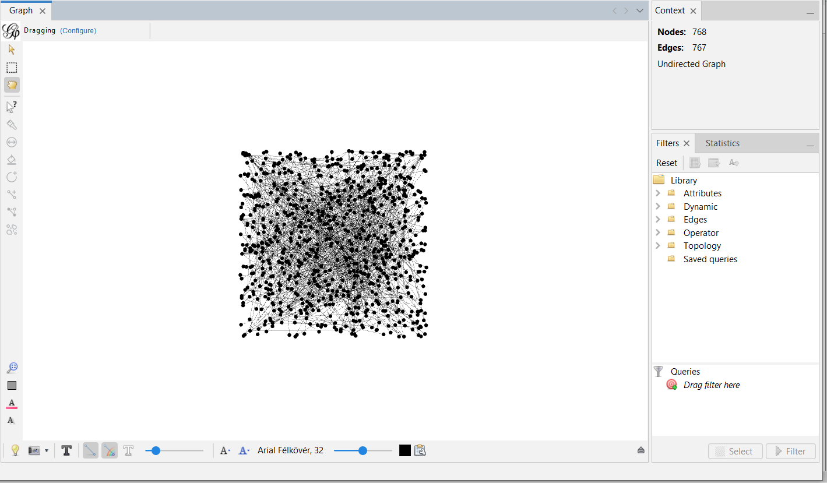
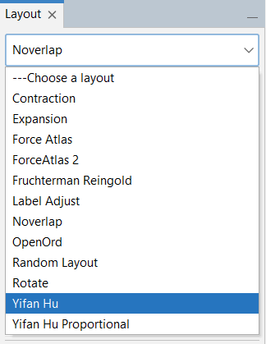

Slide 23
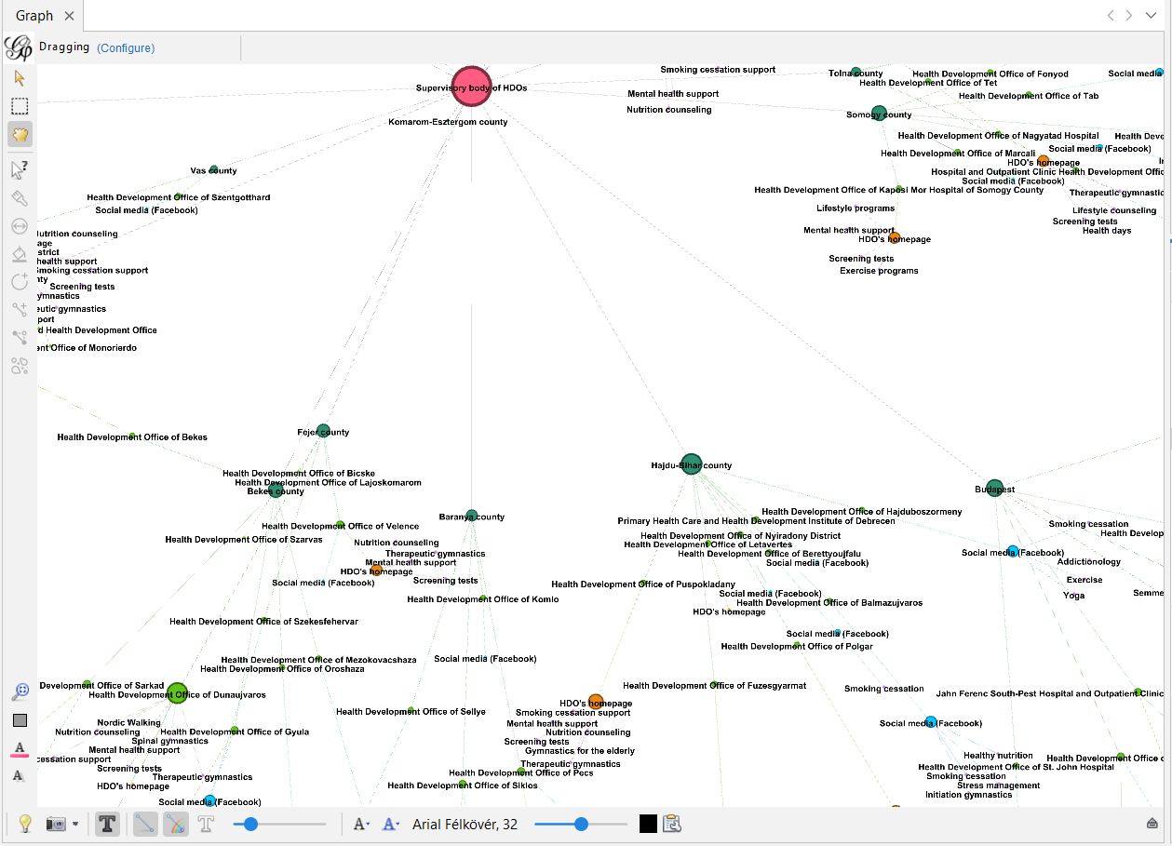

Slide 24
Potential Areas of Collaboration
Joint Research Projects
Scholarship Programs
Internships and Practical Training
Knowledge Transfer and Training Workshops
Resource and Data Sharing
Networking and Interdisciplinary Teams
Policy Development and Advisory Roles
This image was generated using DALL·E by ChatGPT

Slide 25
Summary
Many crises appear in PhD students’ life
Solutions will differ based on context, resources, and problems
Outsider institutions can collaborate with doctoral colleges
Examining national coverage requires multiple measurements and a holistic approach
Translational outcomes can be applied in real life beyond the laboratory

Slide 26
A nationwide network of HDOs can provide valuable assistance to many PhD programs because crises should be seen as opportunities, that always have solutions.
The key is collaboration.

Slide 27
Thank you for your attention!
www.gerontosociology.com
domjan.peter@phd.semmelweis.hu
Supported by the 2024-2.1.2-EKÖP-KDP-2024-00002 University Research Scholarship Programme of the Ministry for Culture and Innovation from the source of the National Research, Development and Innovation Fund and ORPHEUS Organization

