Slide 1
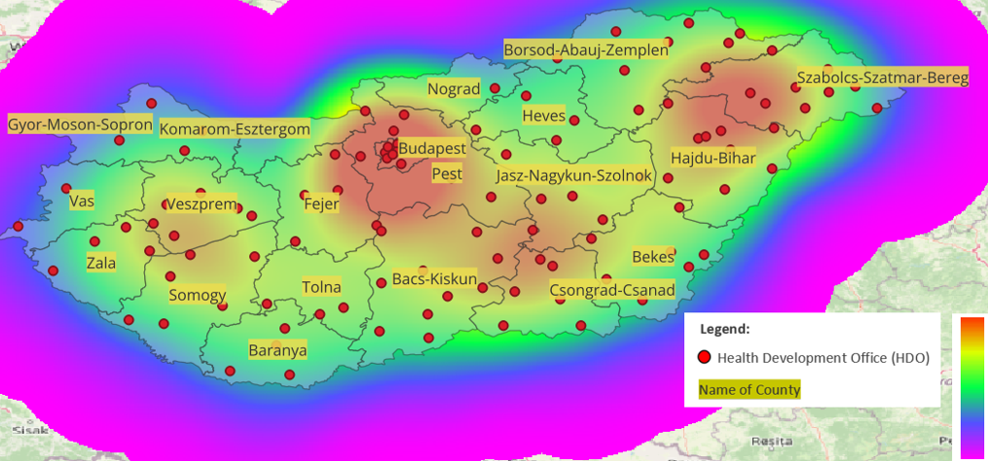
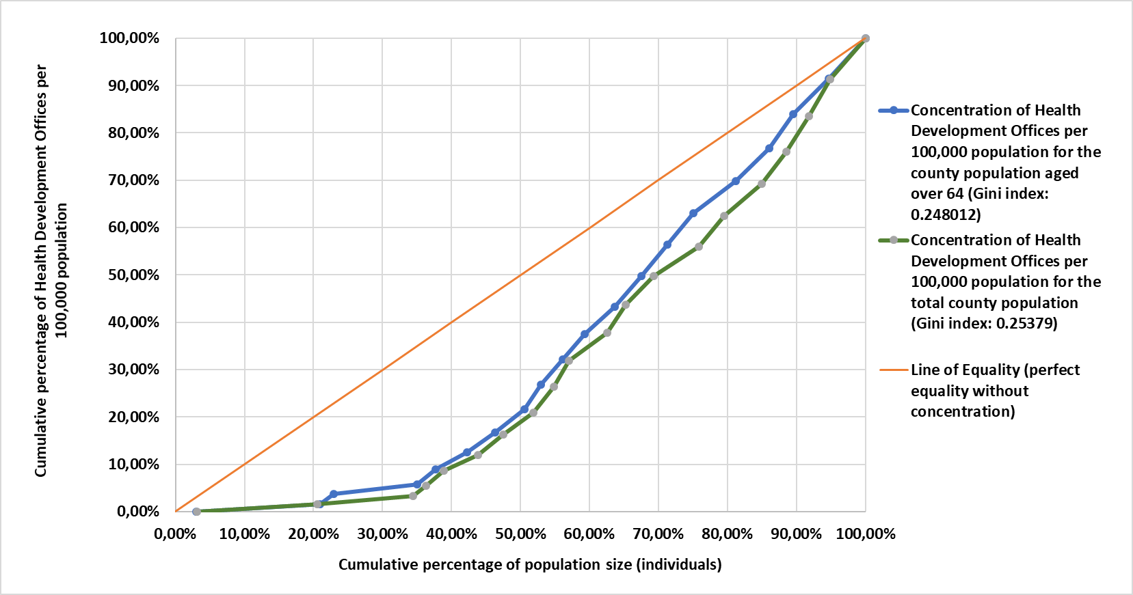
Geographic Distribution, Communication and Preventive Health Services of Health Development Offices in Hungary for the Elderly Populations
Peter Domjan¹, Viola Angyal², Dr. Bertalan Ádám³, Dr. Istvan Vingender³
¹ ² Doctoral College, Health Sciences Division
³ Faculty of Health Sciences, Department of Social Sciences
INTRODUCTION
County | Total population | Population aged 64< | Number of HDOs | LQ index for the 65+ | Total population LQ Index
Komarom-Esztergom | 301 492 | 59 450 | 0 | 0 | 0
Nograd | 182 038 | 39 752 | 1 | 0.4592 | 0.4882
Vas | 249 812 | 53 280 | 2 | 0.6852 | 0.7116
Baranya | 355 315 | 79 127 | 4 | 0.9228 | 1.0006
Gyor-Moson-Sopron | 471 309 | 89 920 | 4 | 0.8120 | 0.7543
Pest | 1 328 790 | 237 294 | 6 | 0.4615 | 0.4013
Budapest | 1 671 004 | 353 466 | 7 | 0.3615 | 0.3723
There are currently 108 Health Development Offices (HDOs) operating in Hungary. These offices provide preventive health services in dietetics, exercise therapy, and mental health for the general population. As publicly funded services, they are available free of charge to those interested, with the primary aim of preventing major chronic diseases. Consequently, these offices focus on reducing health risk factors.
AIMS
Table 1. LQ Index for Counties Underrepresented by HDOs
Our 2023 questionnaire survey on HDOs (CI, α=5%, n=44) revealed that every second visitor to an HDO was over 60 years old. This highlights the significant role these offices play as gerontological settings, effectively influencing the health attitudes and conditions of elderly individuals. A key research question arises regarding the spatial coverage and concentration of HDOs in the different counties of Hungary. In addition to coverage, we also examined the communication platforms used by the offices and the preventive health services they offer to the elderly population.
Our analysis indicated an underrepresentation of HDOs in Budapest and Pest county. County-level disparities, as measured by the LQ index, revealed that, in addition to the capital and its surrounding area, HDOs were also underrepresented in Nograd, Vas, and Gyor-Moson-Sopron counties, with Baranya county joining this group for the elderly population (Table 1).
The Gini Coefficient, approximately 0.25 for both the total population and the older generation, indicated low concentration in the territorial distribution of HDOs across different counties (Figure 1).
These findings were validated using the Herfindahl-Hirschman Index (HHI), which showed a value of 0.063 based on the number of HDOs in the counties, supporting the measurements and indicating low concentration. The Entropy Index, calculated based on the number of HDOs per 100,000 population, yielded a value of 1.2431 for the total population, suggesting high variability at the county level despite the overall low concentration indicating national coverage. The value for the population over 64 was similarly 1.2454. The data suggest that while HDO accessibility varies across counties for both the total and elderly populations, significant spatial concentration is not present, as evidenced by the low Gini index (Figure 1). Examining the stochastic relationship between county population size and the number of HDOs showed an expected positive trend; however, a Pearson correlation coefficient of 0.377 indicated a weak relationship, with a similar coefficient of 0.374 for the elderly population. Excluding the outliers of Budapest and Pest county, the correlation increased to 0.80, and 0.86 for the elderly population.
The analysis also revealed that 87% of the 108 HDOs have digital communication platforms, such as social media or websites. A graph theoretical approach highlighted that inter-office communication is limited, forming a star topology in which the offices operate independently.
MATERIALS AND METHODS
Leveraging advanced geospatial modelling techniques with QGIS 3.34.0 and MS Excel, SPSS 29.0 software, we mapped the locations of HDOs relative to population centres, employing statistical tools such as the Lorenz curve and Gini index, Location Quotient (LQ) index, and Herfindahl-Hirschman Index. These methods allowed for a nuanced analysis of service concentration and the identification of geographic disparities in service provision. The relationship between the population and the number of HDOs was analysed using Pearson correlation. This spatial and demographic study was based on 2022 data. The communication network of HDOs was analyzed using GEPHI 0.10 graph analysis software, with the Yifan Hu layout algorithm applied for visualization. The nodes represented HDOs, counties, and preventive programs for the elderly, facilitated through digital communication channels (e.g., Facebook, websites). Various centrality metrics, including degree distribution, eccentricity, and eigenvector centrality, were used to assess the influence and accessibility within the network.
RESULTS
The Gini index and Lorenz curve of the 108 HDOs indicated an even territorial distribution with low national concentration. Geospatial modelling, which included 19 counties and Budapest, revealed significant variation in the number of operational HDOs per county. The average number of HDOs, including Budapest, was 5.68, ranging from 0 to 11 across the examined territorial units. Statistical indicators confirmed that health prevention providers formed a star topology.
Figure 2. Heatmap of HDO Kernel Density by County in Hungary
Figure 1. Lorenz Curve of HDOs per 100,000 Population Relative to County Population Size (2022) in Hungary
CONCLUSION
The Health Development Office Network in Hungary (N=108) is well-positioned to meet the health maintenance needs of the general population, with a particular emphasis on the elderly. The HDOs provide a range of popular preventive programs for seniors, such as Nordic walking, nutrition counseling, spinal gymnastics, and mental health support. These services establish HDOs as crucial centers for gerontological health promotion in Hungary. However, due to their limited geographic coverage, opening new offices is vital to ensure equal access and enhance preventive care for the elderly.
For county-level comparability, we related the number of HDOs per 100,000 population to the county population size.
32nd Semmelweis Symposium 2024
Budapest, November 11-13, 2024

