Slide 1
Graph Theoretical Approach to Analyzing the Communication Networks of Health Development Offices:
Influencing Positive Health Behaviors
in Elderly Hungarian Population
Peter Domjan, Angyal Viola, Dr. Istvan Vingender
Doctoral College,
Health Sciences Division,
Interdisciplinary Applied Health Sciences Programme

Slide 2

EFI = Health Development Office (HDO)
„Somewhere in Europe….”

Slide 3



Introduction
DIETETCIAN
PHYSIOTHERAPIST
MENTAL HEALTH PROFESSIONAL,
PSYCHOLOGIST
The key is the Health Development Offices (HDO) as health prevention service provider

Slide 4
Importance of Communication
Health Promotion
Communication Content
Elderly
(target audiance)
Communication Channel
Internalization
Better Quality
of Life
Healthy Lifestyle
Direct, Indirect Effect

Slide 5
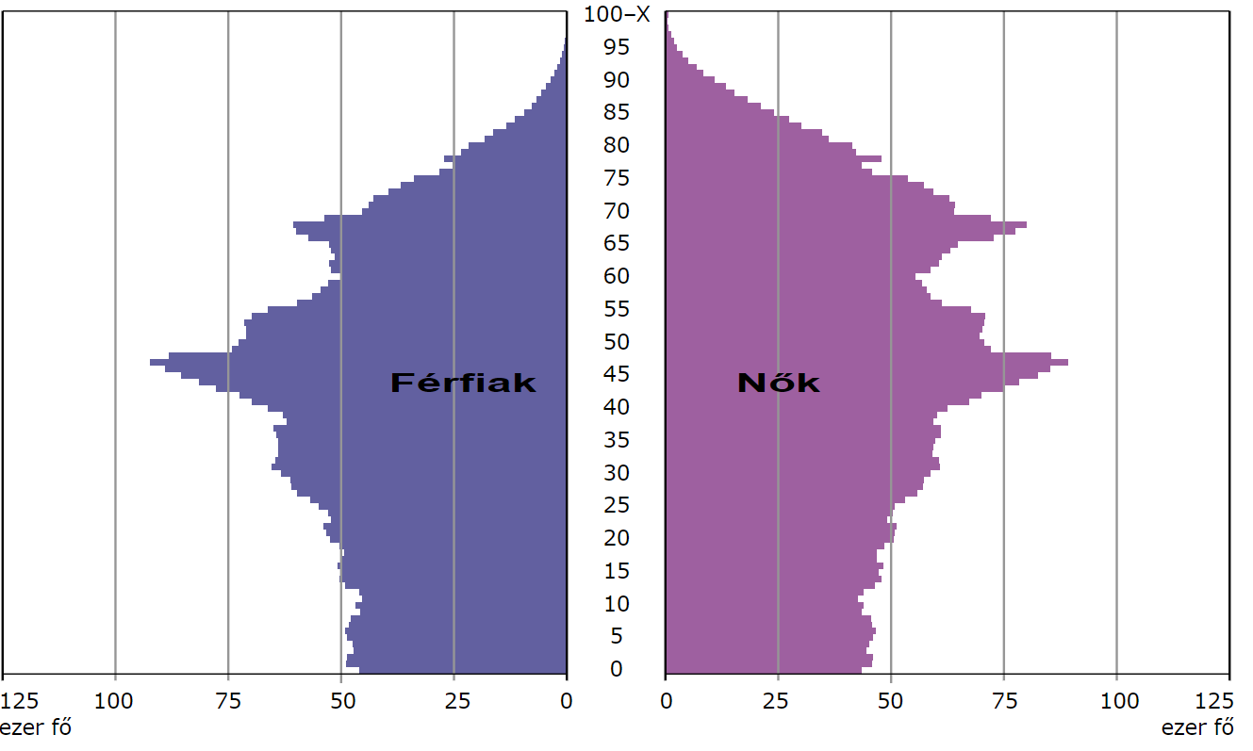
Males
Females
thousand people
thousand people
https://www.ksh.hu/interaktiv/korfak/orszag.html (14.04.2024)

Slide 6
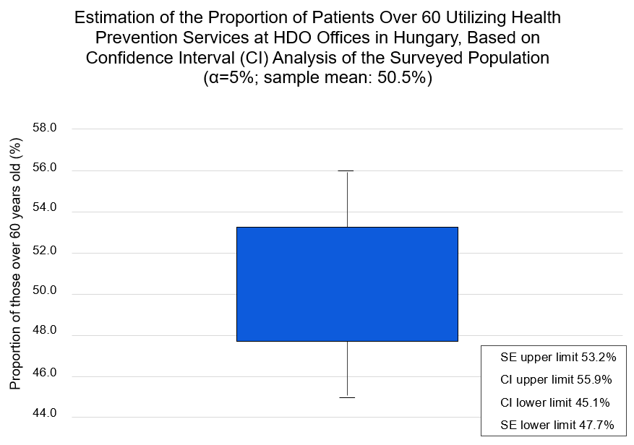
Data collected from a questionnaire filled out by 44 Health Development Offices (HDOs) out of 108. (N=108, n=44)

Slide 7
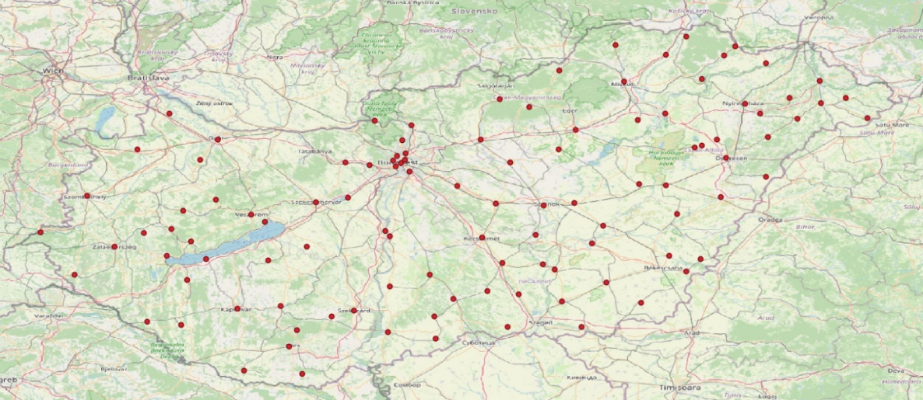
Geographical Placement of HDOs in Hungary
Analysis conducted with QGIS software based on NNK geodata, 01.2024 (N=108)

Slide 8
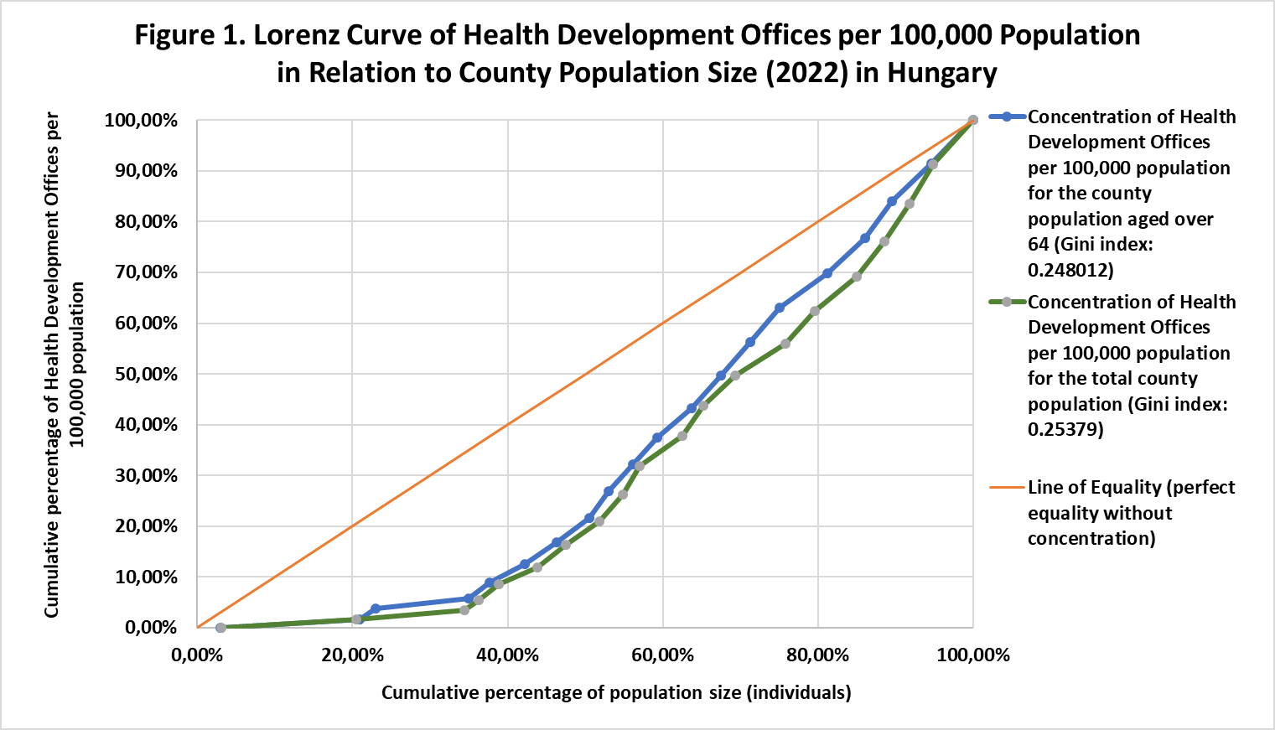
Data collected from 108 Health Development Offices (HDOs) across 19 counties and Budapest.

Slide 9
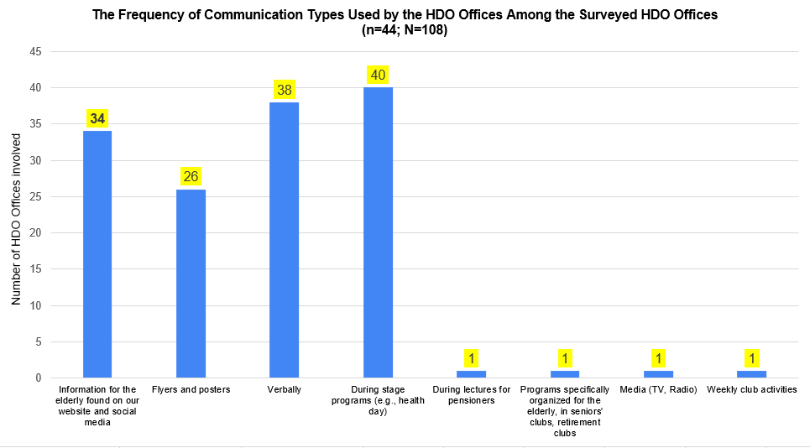
Data collected from a questionnaire filled out by 44 Health Development Offices (HDOs) out of 108. (N=108, n=44)

Slide 10



87% of the 108 HDO Offices have
a digital communication platform
(social media, webpage)

Slide 11
Web Presence of Health Development Offices (HDOs)
Designation | Frequency | %
HDO only has a social media page (Facebook) | 44 | 41%
HDO only has a homepage | 12 | 11%
HDO has a homepage and a social media page (Facebook) | 38 | 35%
HDO does not have a web presence | 14 | 13%
Total: | 108 | 100%

Slide 12
Most Frequently Advertised Health Prevention Programs by HDOs on Facebook
Rank | Name of Health Prevention Programme | Frequency
1. | Smoking cessation | 46
2. | Nutrition counseling | 33
3. | Therapeutic gymnastics | 21
4. | Mental health counseling | 18
5. | Spinal gymnastics | 18
6. | Physical activity | 14
7. | Diabetes Club | 12
8. | Yoga | 12
9. | Nordic Walking | 11
10. | Exercise program | 10

Slide 13
Most Frequently Advertised Health Prevention Programs by HDOs on Their Homepage
Rank | Name of Health Prevention Programme | Frequency
1. | Therapeutic gymnastics | 21
2. | Spinal gymnastics | 18
3. | Nutrition counseling | 18
4. | Mental health support | 18
5. | Screening tests | 16
6. | Smoking cessation support | 15
7. | Exercise programs | 10
8. | Lifestyle counseling | 8
9. | Diabetes Club | 8
10. | Yoga | 7

Slide 14


Slide 15
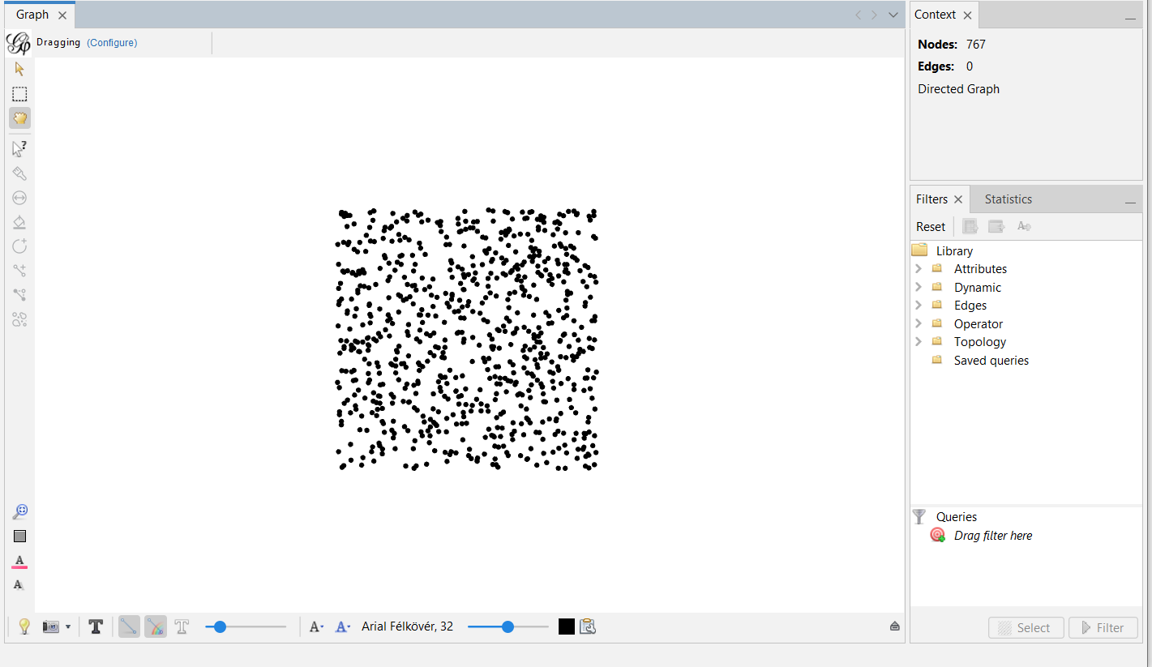
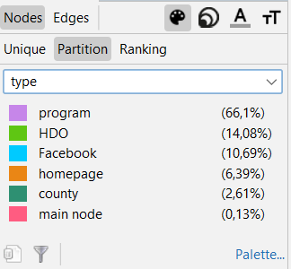

Slide 16
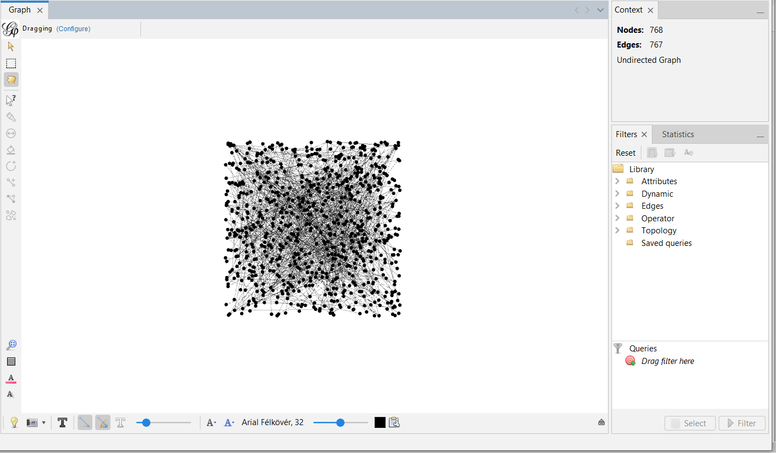


Slide 17
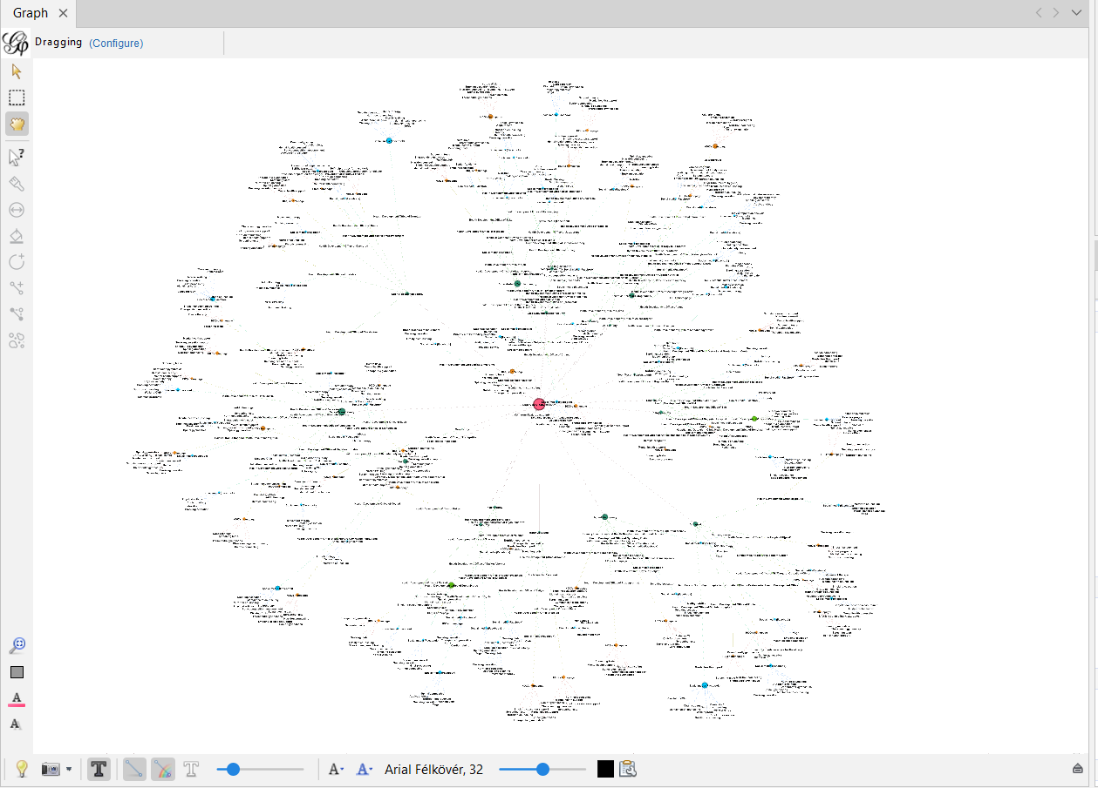

Slide 18
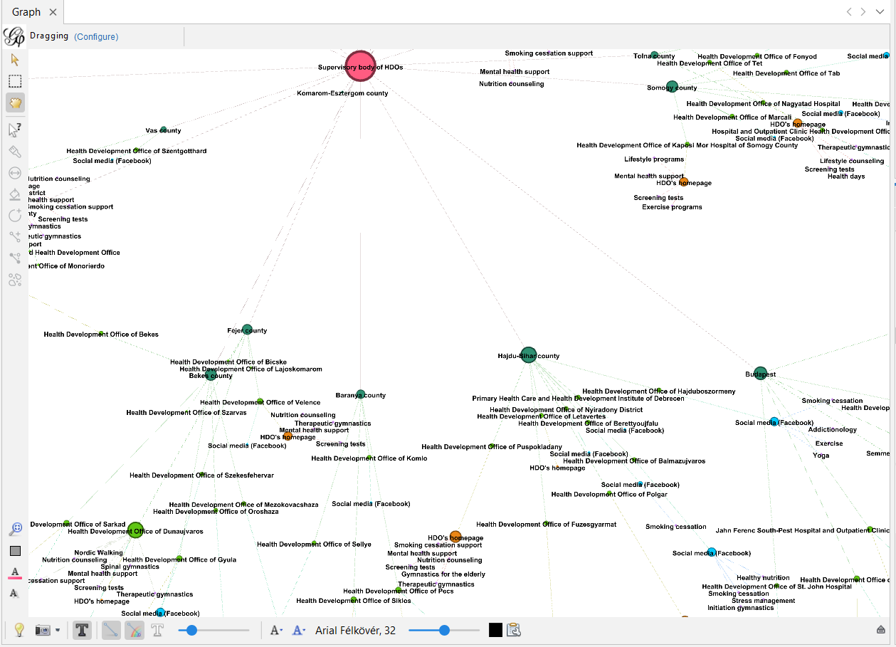

Slide 19
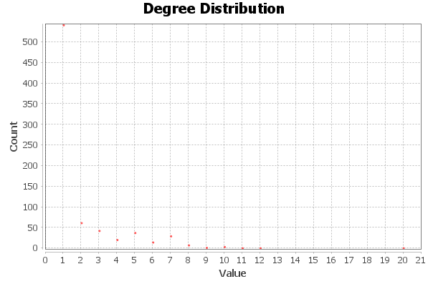
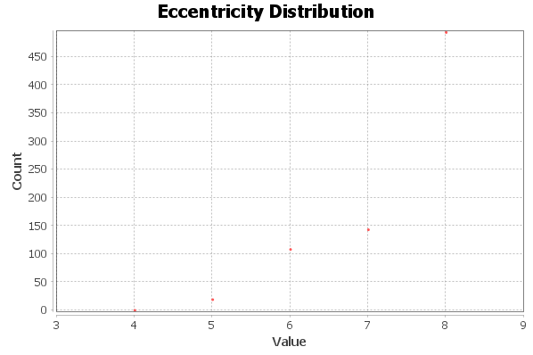
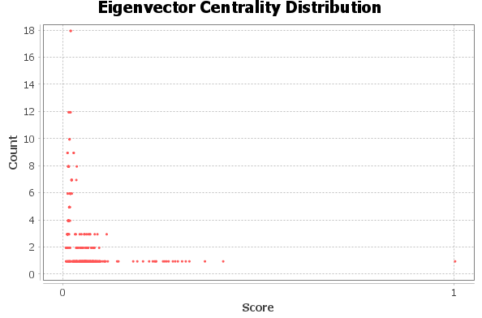

Slide 20
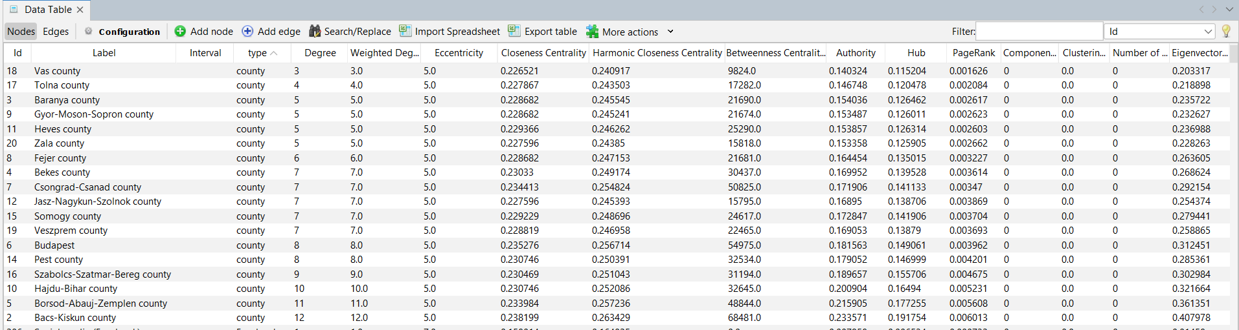
The significance communication provided by the HDO in health prevention for elderly

Slide 21
Summary
Hungary's population is aging, making health prevention increasingly important in old age as well.
In the HDO's clientele, the proportion of elderly is significant, with on average every second client being over 60 years old.
The distribution and concentration of HDO offices make them suitable for serving the health prevention needs of the elderly.
The HDO offices provide different prevention programs for the elderly, which is confirmed by the graph representing the information communication.
It is important to note that there is no communication between the HDOs, and the graph indicates a star topology.

Slide 22
Although the topology and distribution of service organizations vary from country to country, the goal remains the same.
The only question is whether the organization's topology is suitable for serving the health prevention needs of the elderly?
How can we measure it?

Slide 23

Thank you for your attention!
Peter Domjan
domjan.peter@phd.semmelweis.hu

